Slide 1


Marketing Presentation for Guan Lee Hoe Engineering Pte Ltd
Teo Boon Wee 794Z
GLH.com.sg

Slide 2
Marketing Brief

Slide 3

Company Background
Guan Lee Hoe Engineering Pte Ltd. was founded in 1995 as a subcontractor, primarily handling residential projects.
Over the years, we have earned bizSAFE Level STAR and OHSAS 18001 Certification.
Being in the industry for more than 25 years, we offer a wide range of services, from design to fabrication, and installation to maintenance.
Our portfolio includes projects ranging from commercial, retail and industrial.

Slide 4
Past Customers
Capitaland
Mapletree
Far East Organisation
etc

Slide 5
Core Services
Renovation & HVAC (Aircon) for New Commercial spaces (Offices & industrial)
Help achieve BCA Green Mark through more energy efficient HVAC systems achieving up to 50% reduction in electricity bills (https://www1.bca.gov.sg/buildsg/sustainability/green-mark-certification-scheme)
.
Consultation for existing HVAC systems that may be oversized & help determining the right size HVAC requirement, install the relevant equipment to reduce condensation, resolving why aircon is too cold and save electricity bill by up to 20%

Slide 6
Current Lead Generation / Customer Journey
By word of mouth from existing customers
Customers googling for their company name, finding their website & submitting them through the website

Slide 7
Unique Value Proposition
Guan Lee Hoe specialises in energy efficient HVAC consultancy and installation
They can save up to 50% of electricity bills through their HVAC installations over competitors
They can also improve the efficiency or solve problems you face with your current HVAC system

Slide 8
Marketing Objective
To do increase awareness in the SME business segment and thereby increasing renovation & HVAC leads for Guan Lee Hoe

Slide 9
Known Competitors
https://www.acaengrg.com/
https://www.carrier.com/commercial/en/sg/
https://naturalcool.com.sg/
https://koyotech.com/
https://cosyace.com/

Slide 10
Ideal Persona
SME Business owners moving offices or renovating new premises
They would require renovation in the new office including HVAC systems & reinstate the old premises
Or they are looking to renovate their existing premises including replacing the HVAC
New building owners are looking to achieve the BCG Green Mark certification
See past projects here for content marketing

Slide 11
Marketing Scope per Student
Each student chooses only one persona and build a marketing plan for that one persona
You are encouraged to group together to share ideas and research together
However, your submitted capstone work must be done individually
You can consider using ChatGPT for brainstorming or copywriting only but Do Not use ChatGPT for answers - as you are still learning digital marketing, you cannot tell if ChatGPT answers are correct

Slide 12
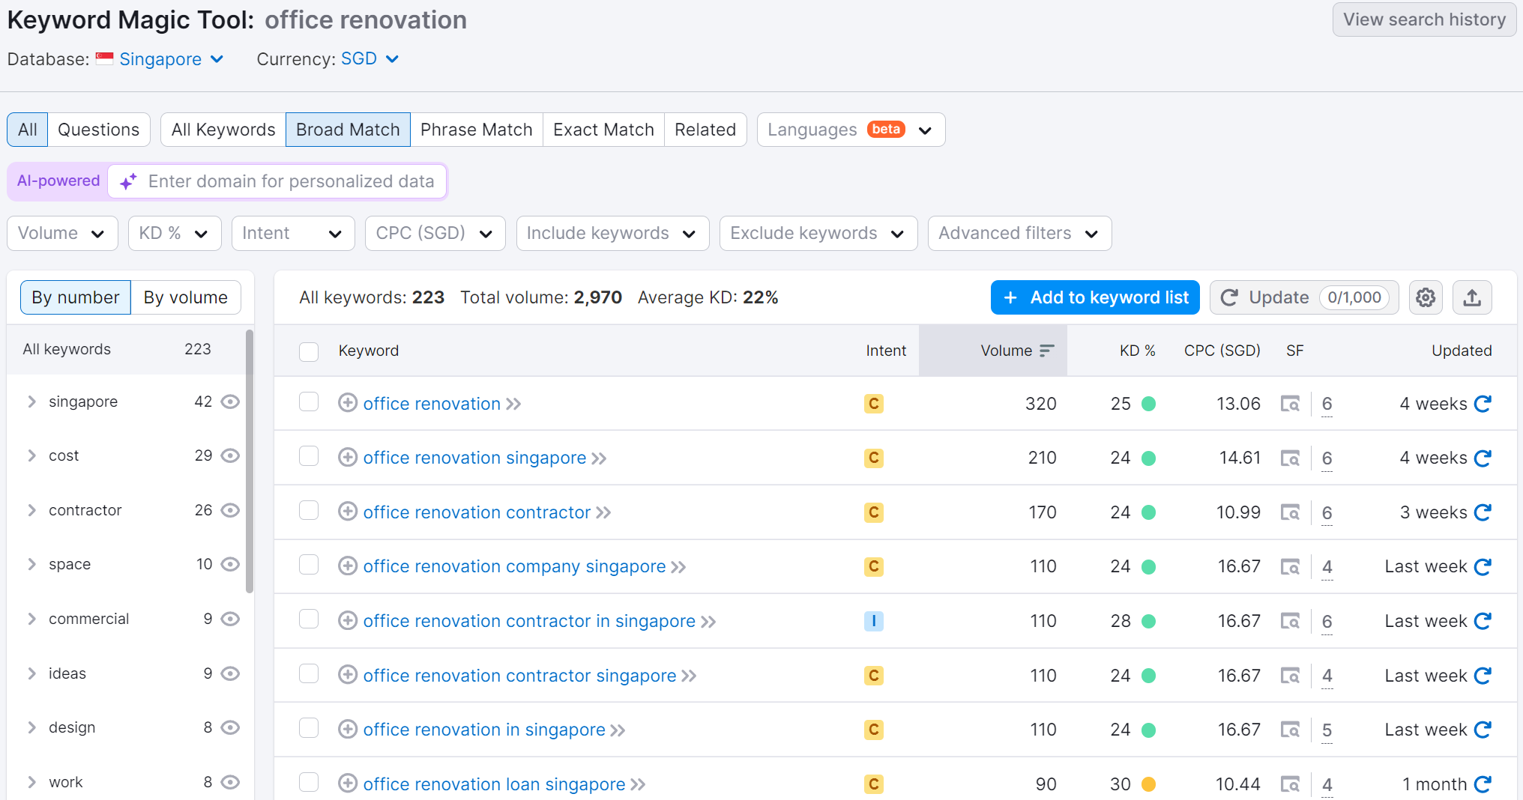
Initial Research “office renovation”

Slide 13
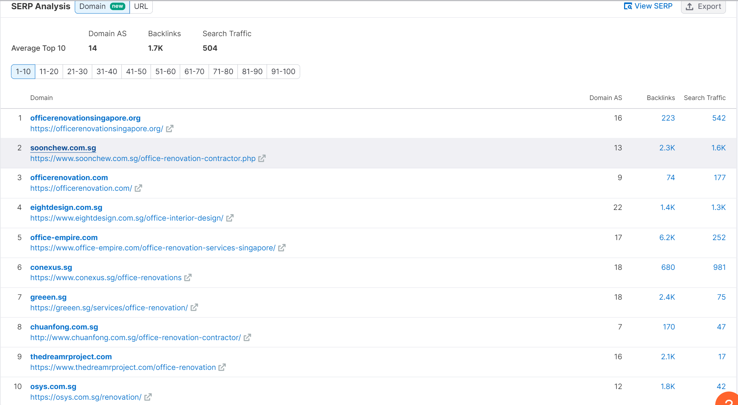
Initial Research “office renovation”

Slide 14
Initial Research “Office Renovation”

Slide 15
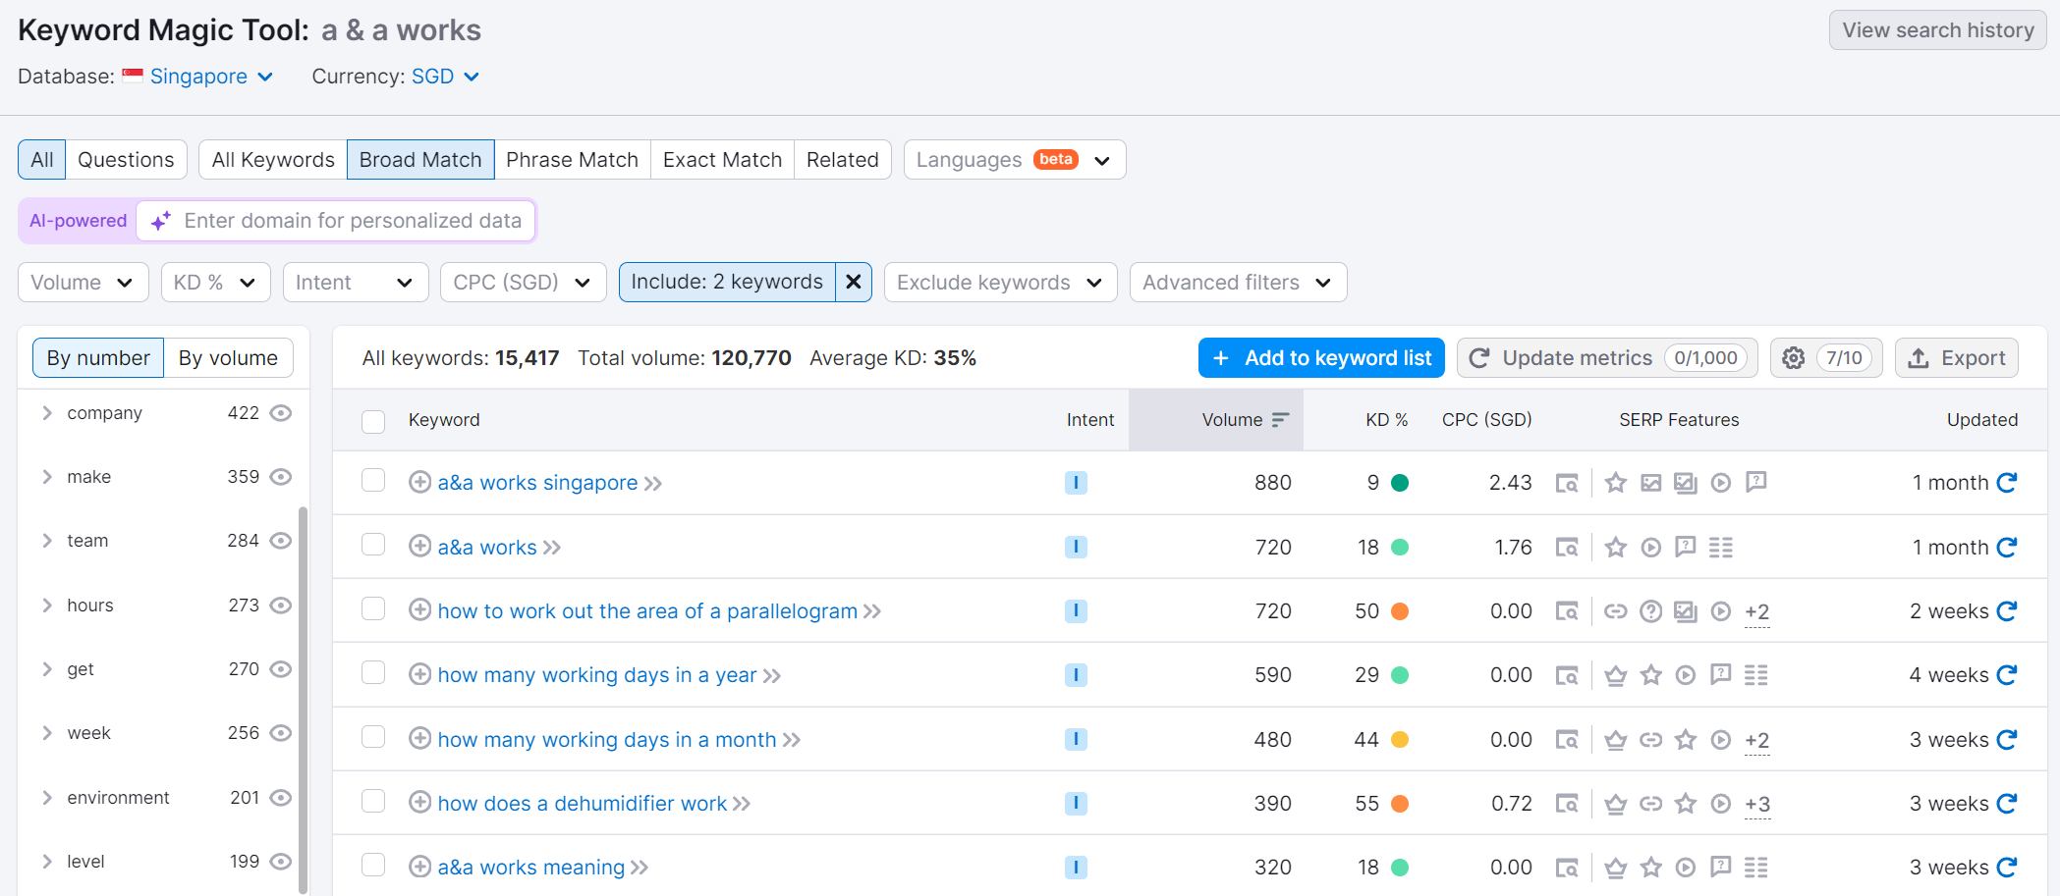
Initial Research “A & A Works”

Slide 16
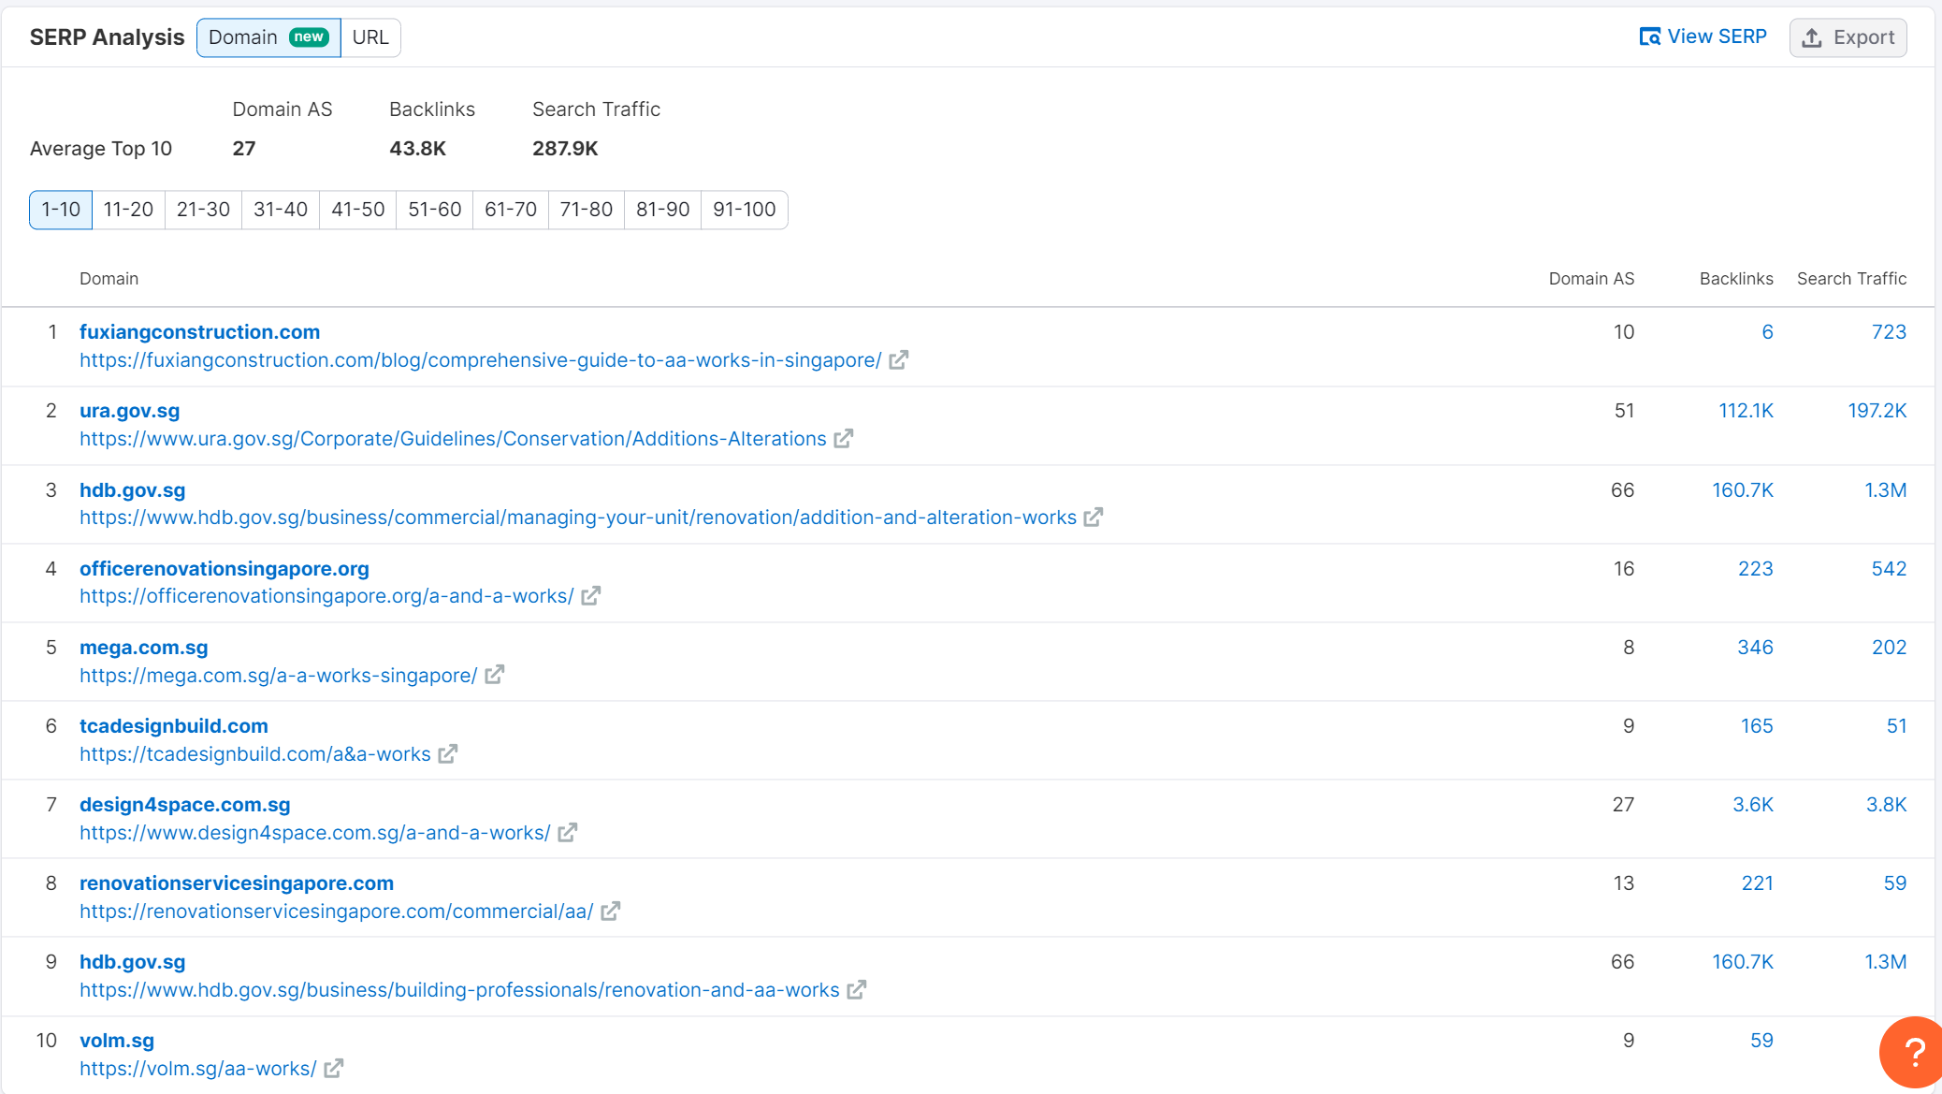
Initial Research “A & A Works”

Slide 17
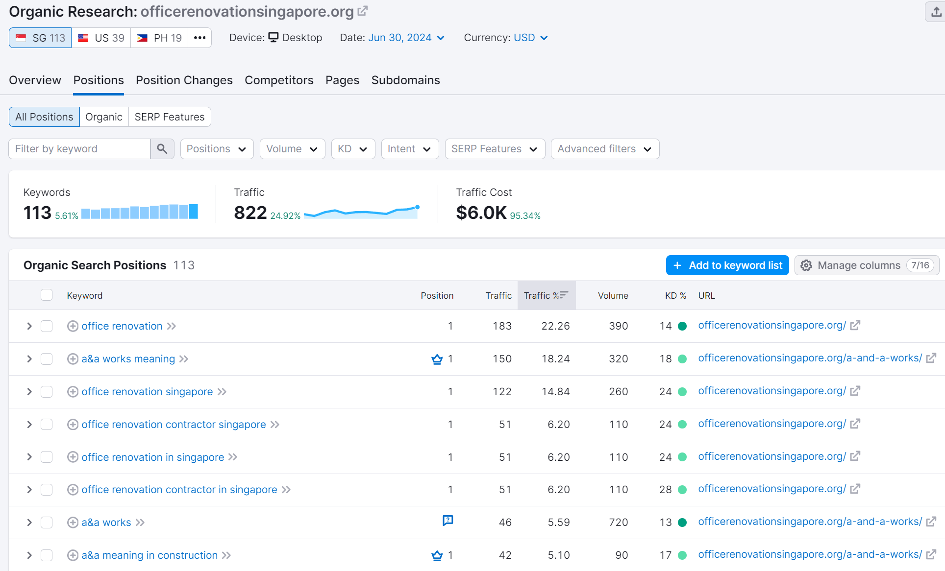
Initial Research officerenovationsingapore.org

Slide 18
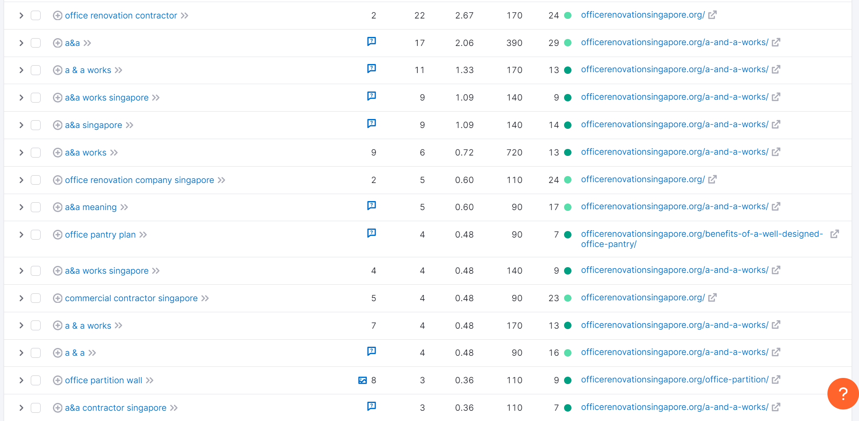
Initial Research officerenovationsingapore.org

Slide 19
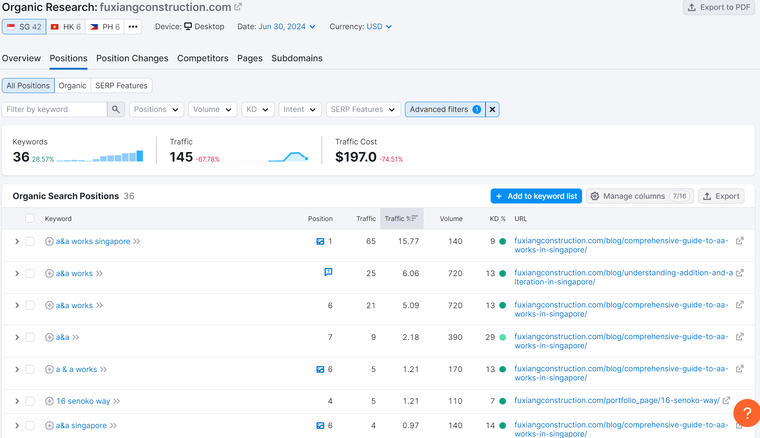
Initial Research fuxiangconstruction.com

Slide 20
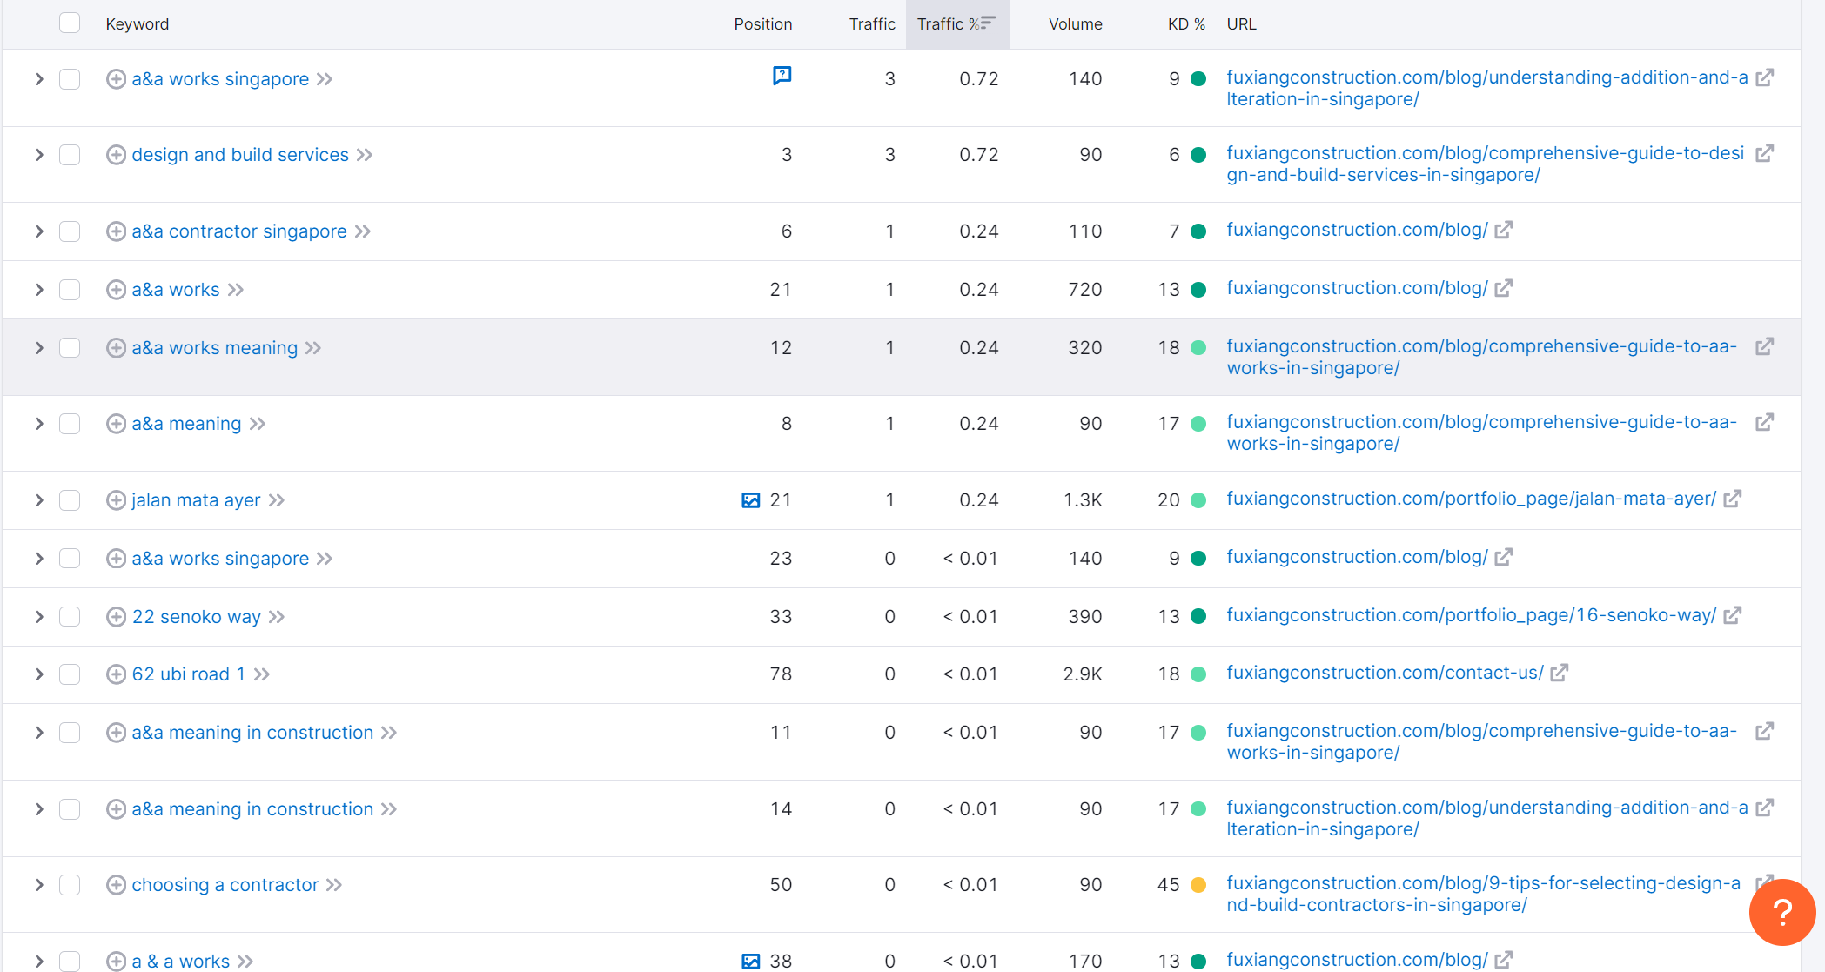
Initial Research fuxiangconstruction.com

Slide 21
Expected Deliverables (To pass this module)
Scoping the purpose & objectives of a digital marketing campaign in accordance with a company’s requirements
A SWOT analysis on competitor landing pages and creating a conversion focused landing page that stands out from the competition
One highly engaging content for web (blogpost, brochure, EDM, video, etc) and one social media post (image or video with caption along with copywriting)
One Ad copy for search, display, and/or social media and an -SEO optimised blog article or lead magnet for content marketing
A completed setup of Google Ads Search or Display campaign to market a company’s products & services
A completed setup of social media campaign mockup to drive awareness and conversions for a company’s products & services
An evaluation of digital marketing campaigns (across the user journey, e.g. website, advertising performance, content analytics) using various conversion optimisation models to meet company’s requirements & objectives

Slide 22
Marketing Plan

Slide 23
Executive Summary
Provide a brief overview of the main points of the marketing plan, here’s an example below, please modify it to suit your marketing
Business Objective: Increase awareness in the SME business segment
Target Market: SME Business owners moving offices or renovating new premises
Market Need: Office ventilation expert
Notes:
Trainer Notes: - Do this slide last after your marketing plan has been developed

Slide 24
Executive Summary
Provide a brief overview of the main points of the marketing plan, here’s an example below, please modify it to suit your marketing
Product Overview: Specific selling points of your product/service that the persona look out for
Market Strategy:
Which channels, what sort of content do you intend to use to execute marketing to bring them from awareness through consideration to deciding to give you their business
Note: Do this last, this is a summary of the entire marketing plan & execution

Slide 25
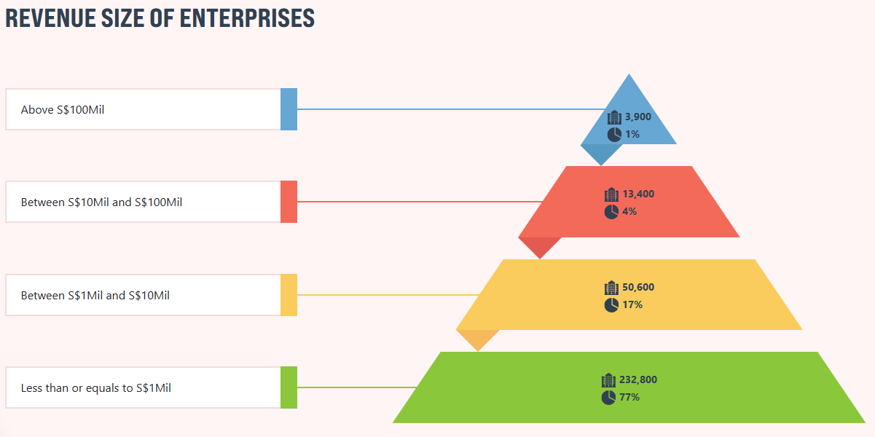
Background Information

Slide 26
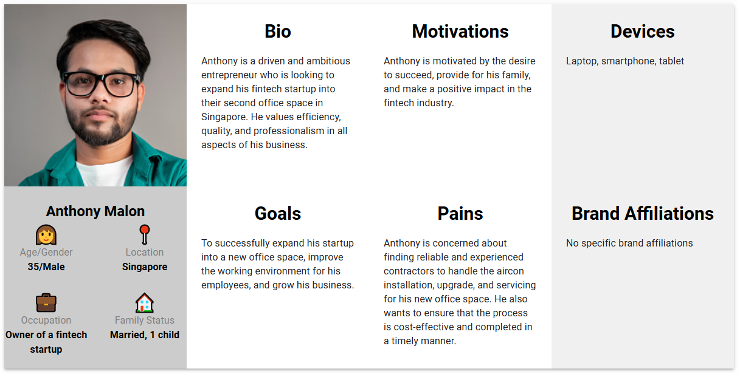
Persona / Ideal Customer
Anthony Malon - The ambitious entrepreneur

Slide 27
Persona / Ideal Customer
Psychographic Information
Life stage | Young Parent
Pain Points | Several feedback from staff about the office aircon being too cold or dripping water
Motivations | Expand company operations regionally Attract and retain talents to work in his company
Challenges | Limited knowledge/experience regarding office ventilation
Core Values & Beliefs | Provide a conducive working environment for his office staff

Slide 28
Persona / Ideal Customer
Service Needs & Preferences
Online Behaviour How they search for or receive information online | Google Search, Social Media
Preferred Communication Channels How they prefer to communicate (e.g., email, text, app notifications). | Whatsapp, email
Service Expectations Key attributes they look for in the Service/Product | Values pre-sales consultation, product reliability
Price Sensitivity What do they consider too cheap, too expensive or value for money? What would they pay more for? | View office air-conditioning as essential, also willing to invest in after-sales service, more energy-efficient solutions etc

Slide 29
Persona / Ideal Customer
Decision Making Process
Information Sources Where they turn for health-related advice (e.g., online resources, peer groups, healthcare professionals). | Online sources, business partners
Influencers Individuals or groups that influence their healthcare decisions (e.g., family members, celebrities, social media influencers). | Social media influencers, business associates
Barriers to entry Perceived obstacles to using a medical concierge service (e.g., cost, skepticism, lack of awareness). | Lack of awareness
Decision Triggers Events or conditions that prompt the search for a medical concierge service (e.g., diagnosis, lifestyle change, recommendation). | Complaints from staff

Slide 30
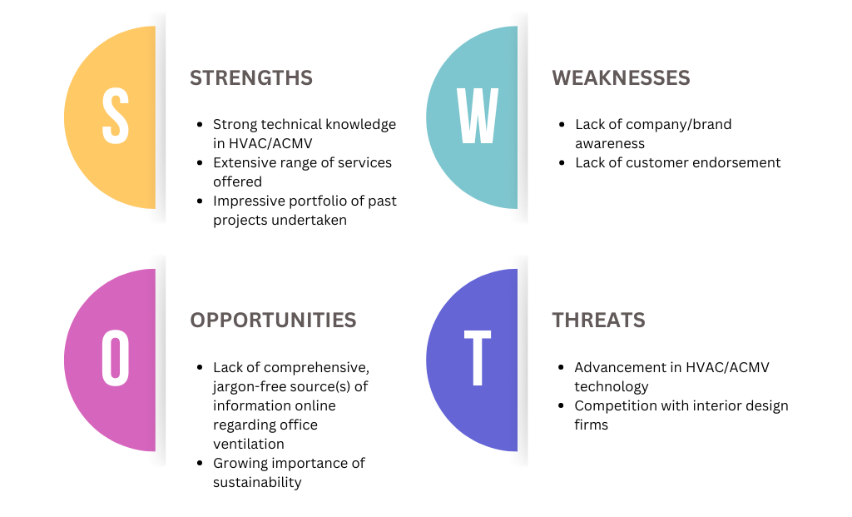
SWOT Analysis of My Company

Slide 31
Competitive Analysis - Website
Use the digital marketing tools to assess your company & competitors’ website performance such as;
https://www.semrush.com/
https://neilpatel.com/ubersuggest/
https://www.similarweb.com/
Highlight ONLY key areas where each site has done particularly well & gaps which your company can leverage on as opportunity.
Consider both in areas of performance as well as content from the personas’ perspective.

Slide 32
Competitive Analysis - Website
Suggested Areas to look out for
Category | Area to Look Out For | Why It Is Important
Design and Usability | User Interface (UI) Design | First impressions matter; a well-designed UI can enhance user experience, making the site more engaging and accessible.
 | User Experience (UX) | Ensures the website is user-friendly and intuitive, reducing bounce rates and increasing conversion rates.
 | Mobile Responsiveness | With increasing mobile usage, ensuring the website is mobile-friendly is crucial for reaching a wider audience.
Content | Quality and Relevance | High-quality, relevant content improves SEO rankings, engages readers, and establishes authority.
 | Content Strategy | A well-defined content strategy can attract and retain a specific target audience, leading to higher engagement.
SEO and Visibility | Keywords and Optimization | Effective use of keywords can improve a website's visibility on search engines, driving more organic traffic.
 | Backlink Profile | A strong backlink profile can enhance domain authority and improve search engine rankings.
Technical Performance | Site Speed | Faster websites provide a better user experience, affecting rankings and conversion rates.
 | Security (HTTPS) | Ensures data protection, builds trust with users, and is a ranking factor for search engines.
Social Media Presence | Integration and Activity | Active social media presence and integration can drive traffic, enhance brand visibility, and improve engagement.
Marketing Tools | Use of Analytics | Analytics provide insights into user behavior, helping to tailor strategies for better results.
 | Email Marketing Integration | Effective email marketing can drive engagement, retention, and conversions.
Customer Engagement | Reviews and Testimonials | Positive reviews and testimonials build trust and credibility, influencing purchasing decisions.
 | Interactive Elements | Engaging the audience through polls, surveys, or chatbots can enhance user engagement and provide valuable feedback.

Slide 33
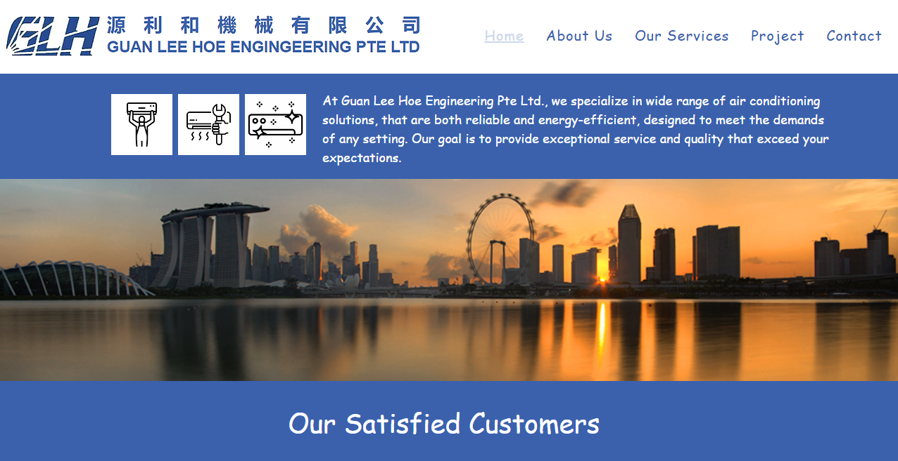
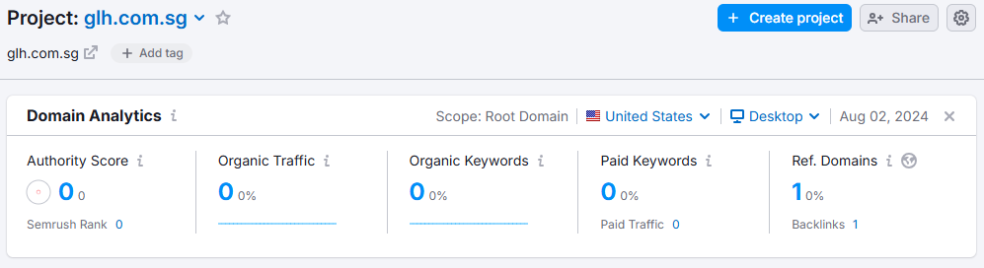
Competitive Analysis - Website

Slide 34
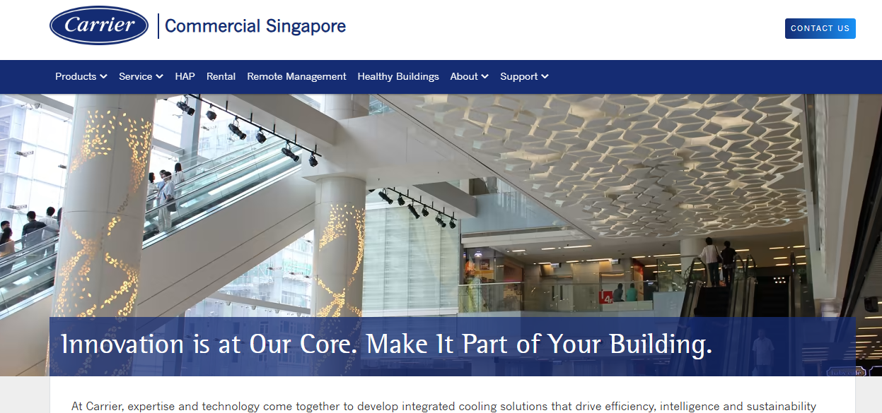
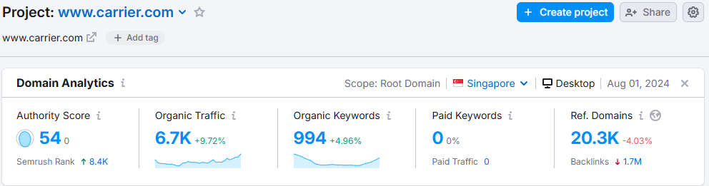
Competitive Analysis - Website

Slide 35
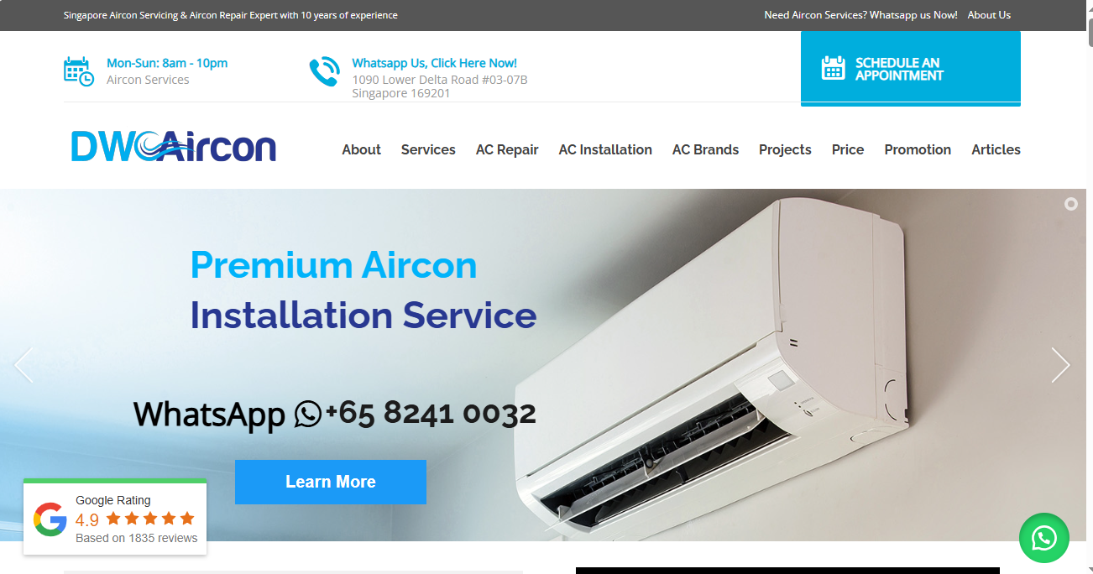
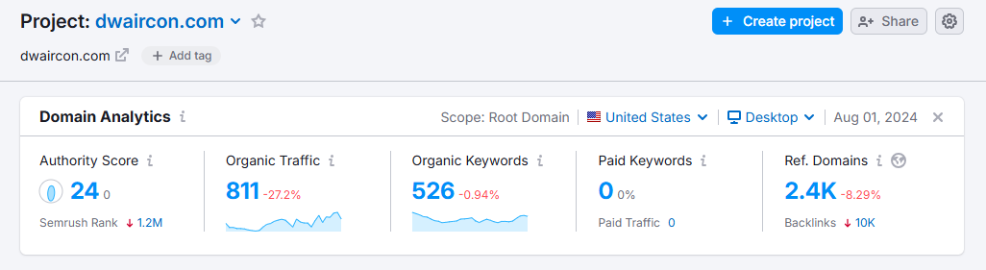
Competitive Analysis - Website

Slide 36
Competitive Analysis - Website
Category | Area to Look Out For | GLH | Carrier | DWAircon
Design and Usability | User Interface (UI) Design | ✔ | ✔✔✔ | ✔✔
 | User Experience (UX) | ✔ | ✔✔✔ | ✔✔
 | Mobile Responsiveness | ✔✔✔ | ✔ | ✔✔
Content | Quality and Relevance | ✔ | ✔✔ | ✔✔✔
 | Content Strategy | ✔ | ✔✔ | ✔✔✔
SEO and Visibility | Keywords and Optimization | ✔ | ✔✔ | ✔✔✔
 | Backlink Profile | ✔ | ✔✔✔ | ✔✔

Slide 37
Competitive Analysis - Website
Category | Area to Look Out For | GLH | Carrier | DWAircon
Technical Performance | Site Speed | ✔✔✔ | ✔✔ | ✔
 | Security (HTTPS) | ✔ | ✔ | ✔
Social Media Presence | Integration and Activity | ✔ | ✔✔ | ✔✔✔
Marketing Tools | Use of Analytics | ? | ? | ?
 | Email Marketing Integration | ? | ? | ?
Customer Engagement | Reviews and Testimonials | ✔ | ✔✔ | ✔✔✔
 | Interactive Elements | ✔✔ | ✔ | ✔✔✔
Backlink Profile | Domain Rating | 0.2 | 83 | 36
 | Backlinks | 1 | 347 | 4.2k
 | Linking Websites | 1 | 13 | 456

Slide 38
Competitive Analysis - Social Media
Check competitors’ social media channels as well as your company to determine social media performance.
Highlight key areas where each site has done particularly well & gaps which your company can leverage on as opportunity. Examples are posts with high engagement numbers as well as the ones with most suitable content to your persona

Slide 39
Competitive Analysis - Social Media
Suggested Areas to look out for
Category | Area to Look Out For | Why It Is Important
Audience Engagement | - Likes, shares, comments, and reactions - Follower growth rate | Understanding engagement helps gauge content resonance and audience growth strategies. It indicates what type of content generates interaction and can inform your content strategy.
Content Strategy | - Types of content posted (videos, images, live streams, etc.) - Frequency and timing of posts | Identifying the content mix and posting schedule can reveal what keeps the audience engaged and when they are most active, helping to optimize your content strategy.
Advertising | - Ad formats used (carousel, video, etc.) - Targeting strategies - Estimated ad spend | Analyzing competitors' ads provides insight into creative strategies and audience targeting, offering clues to effective advertising practices and budget allocation.
Engagement Tactics | - Contests, giveaways, polls, etc. - Use of Facebook Stories and Groups | Special engagement tactics can significantly increase interaction and loyalty. Understanding these can help in crafting compelling campaigns.
User Interaction | - Response time to comments and messages - Type of responses (personalized vs. automated) | Prompt and effective communication builds trust and community. Observing how competitors manage interactions can improve your customer service approach.
Performance Metrics | - Engagement rate- Click-through rate (CTR) for ads - Conversion rate | Metrics offer a direct comparison of effectiveness. Analyzing these can help in setting realistic performance goals and refining your marketing strategies.
Branding and Positioning | - Tone of voice - Visual branding in content and ads | The way competitors position themselves and communicate can provide insights into market expectations and opportunities for differentiation.

Slide 40
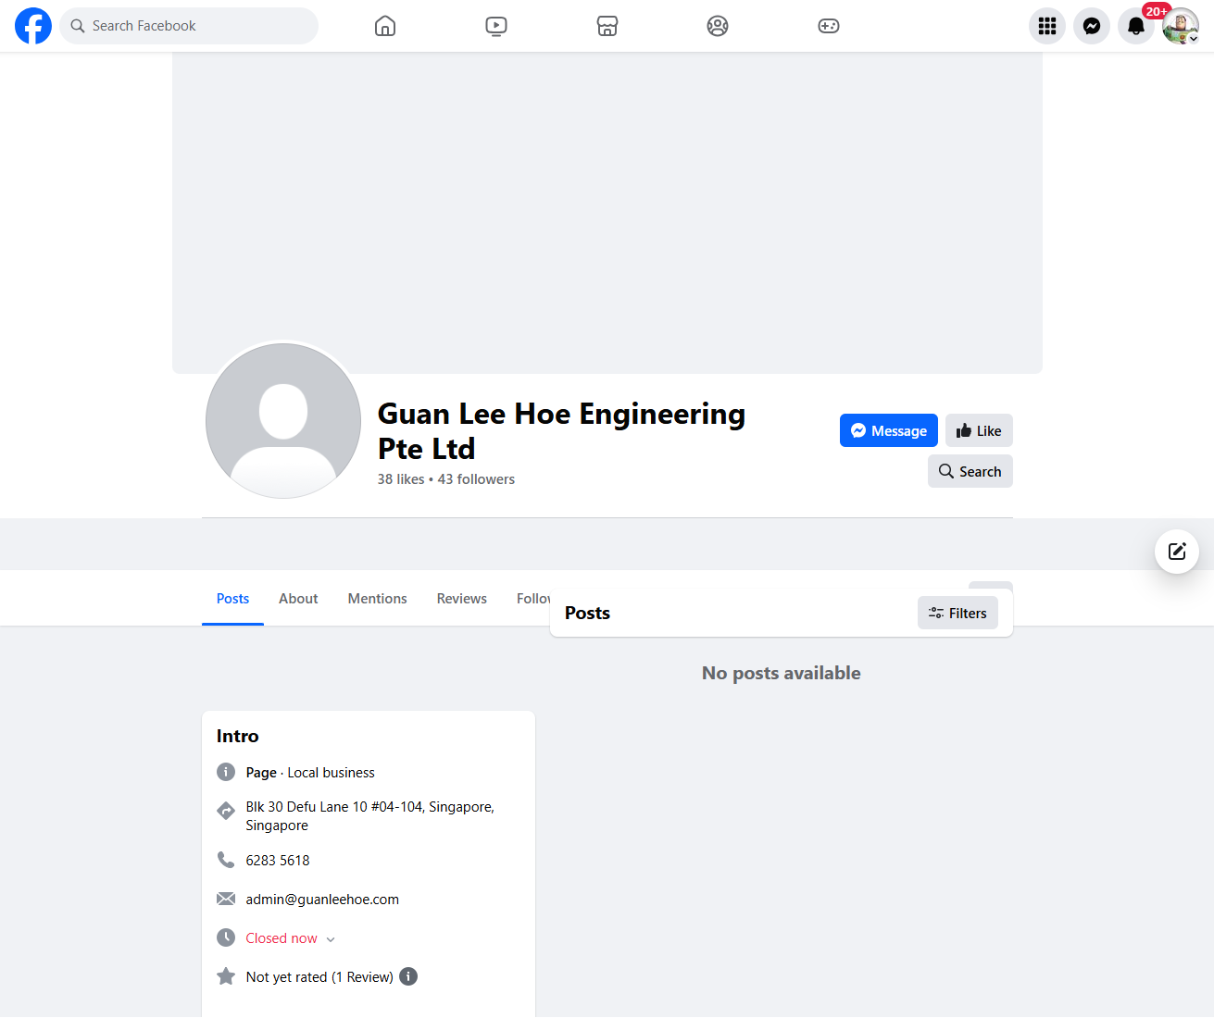
Competitive Analysis - Social Media
Low engagement on FB
38 likes, 43 followers
No posts
No header/avatar image

Slide 41
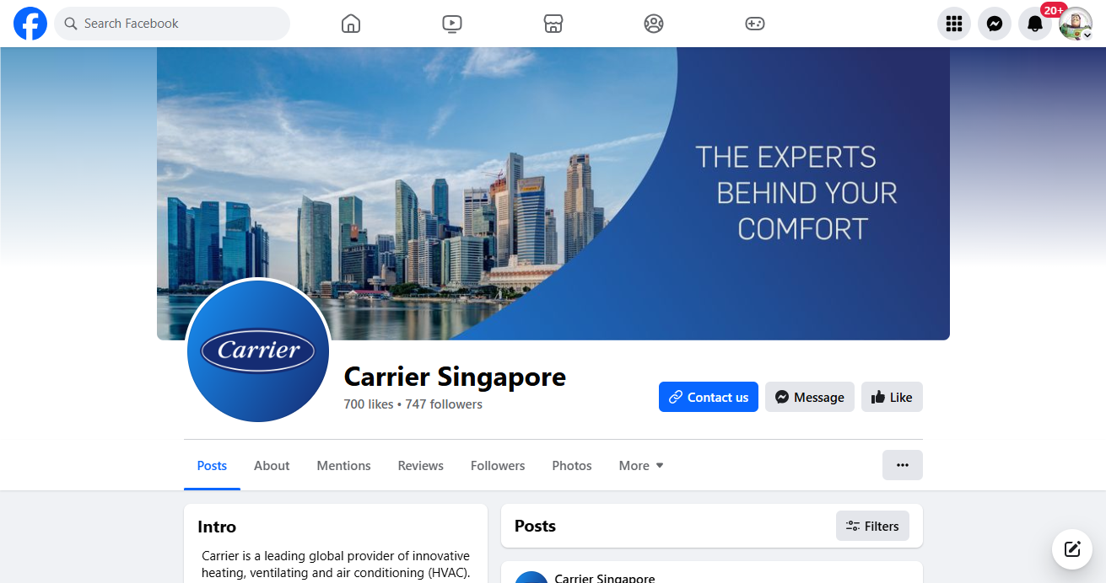
Competitive Analysis - Social Media
Moderate engagement on FB
701 likes, 749 followers
Regular posts
Header/avatar image

Slide 42
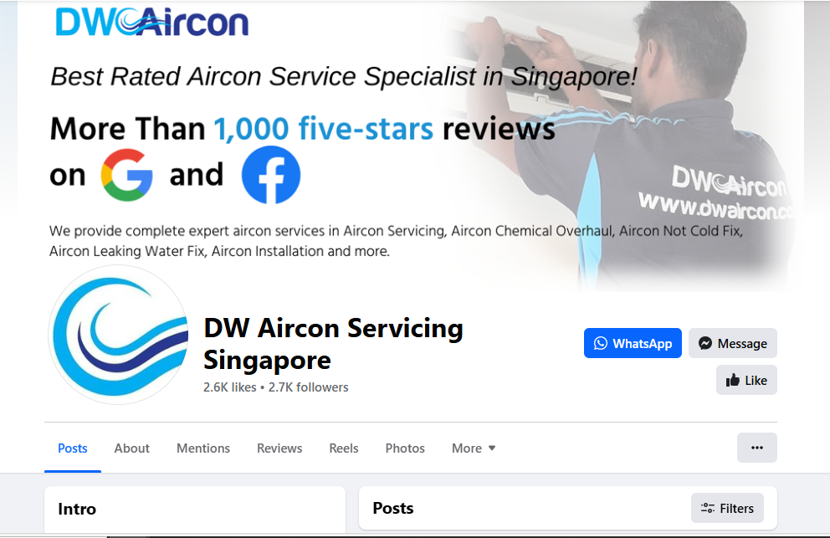
Competitive Analysis - Social Media
Good engagement on FB
2.6k likes, 2.7k followers
Regular/recent/informative posts
Eye-catching header/avatar image

Slide 43
Competitive Analysis - Social Media Ads
Check Meta Ad Library of your company & competitors’ to determine if they are running ads
https://www.facebook.com/ads/library/
Alternatively look at the page’s page transparency
Highlight ONLY key areas where each site has done particularly well & gaps which your company can leverage on as opportunity.
Consider both in areas of performance as well as content from the personas’ perspective.

Slide 44
Competitive Analysis - Social Media Ads
Suggested Areas to look out for
Category | Area to Look Out For | Why It Is Important
Audience Targeting | Demographics, Interests | Understanding the audience your competitors target can reveal gaps in the market or opportunities to refine your own targeting strategies.
Ad Content | Messaging and Value Proposition | Analyzing the core messages and value propositions helps to differentiate your offerings and identify what resonates with the audience.
 | Visual Elements | The use of images, videos, and design in ads can influence engagement rates; understanding what works can inform your creative strategy.
Ad Types | Formats Used | Identifying which ad formats (e.g., carousel, video, stories) competitors use most effectively can guide your ad format choices.
Engagement | Likes, Shares, Comments | High engagement rates indicate content resonance; analyzing these metrics helps identify effective content types and topics.
Call to Action (CTA) | Clarity, Urgency | The effectiveness of CTAs can significantly impact conversion rates; studying competitors' CTAs can inspire more compelling ones.
Campaign Structure | Campaign Goals, Ad Sets | Understanding the structure and goals of competitors' campaigns can provide insights into effective campaign management strategies.
Budget and Bidding | Estimated Ad Spend | Although exact budgets may be unknown, indicators of ad spend and bidding strategies can inform your budget allocation decisions.
Performance Metrics | Click-Through Rate (CTR), Conversion Rate | Benchmarking these metrics can help gauge the effectiveness of your ads relative to the competition and industry standards.
Trends and Innovation | Use of New Features or Platforms | Observing how competitors adopt new social media features or platforms can reveal emerging trends and opportunities for innovation.

Slide 45
Competitive Analysis - Search Engine Marketing
Use the digital marketing tools to assess your company & competitors’ search ads performance such as Semrush & Google Ad Transparency here
https://adstransparency.google.com/?region=SG
Highlight ONLY key areas where each site has done particularly well & gaps which your company can leverage on as opportunity.
Consider both in areas of performance as well as content from the personas’ perspective.

Slide 46
Competitive Analysis - Search Engine Marketing
Suggested Areas to look out for
Category | Area to Look Out For | Why It Is Important
Keywords | Targeted Keywords | Understanding the keywords your competitors target can reveal gaps in your strategy or highly contested areas worth focusing on.
 | Keyword Match Types | Analyzing the match types used (broad, phrase, exact) can offer insights into competitors' targeting precision and strategy.
Ad Copy | Headlines and Descriptions | Effective ad copy is crucial for high CTR. Studying competitors' copy can inspire ways to differentiate and improve your own ads.
 | Unique Selling Propositions (USPs) | Identifying competitors’ USPs in ads can help you refine your value proposition to stand out in the search results.
Landing Pages | Page Design and Content | The design and content of landing pages directly impact conversion rates. Analyzing these can provide ideas for optimization.
 | Call to Action (CTA) | Effective CTAs on landing pages are key for conversions. Studying competitors’ CTAs can inspire more compelling ones for your pages.
Ad Extensions | Types of Extensions Used | Ad extensions enhance ad visibility and effectiveness. Understanding which extensions competitors use can guide your extension strategy.
Bidding Strategies | Ad Position and Visibility | Although exact bid amounts are unknown, ad positions can indicate competitors’ bidding strategies and priority keywords.
Performance Metrics | Click-Through Rate (CTR), Conversion Rate | Benchmarking these metrics can help gauge the effectiveness of your ads and landing pages relative to the competition.
Geographic Targeting | Targeted Locations | Analyzing geographic targeting can reveal market priorities and regional strategies, offering insights into potential niche markets.
Scheduling | Ad Scheduling | Competitors’ ad schedules can indicate when they aim to capture the most traffic, informing your own ad timing decisions.
Budget Allocation | Estimated Spend | While exact budgets may be confidential, indications of spend can inform your budget decisions and reveal competitor priorities.
Trends and Innovation | Use of New Ad Features or Technologies | Keeping an eye on competitors’ adoption of new features or technologies can highlight trends and opportunities for innovation.

Slide 47
Competitive Analysis - Email Marketing
Subscribe to their mailing list & review their email marketing to assess your company & competitors’ email marketing performance.
Highlight key areas where each site has done particularly well & gaps which your company can leverage on as opportunity.

Slide 48
Competitive Analysis - Email Marketing
Suggested Areas to look out for
Category | Area to Look Out For | Why It Is Important
Audience | Segmentation Strategies | Understanding how competitors segment their audience can offer insights into more personalized and effective email strategies.
Content | Subject Lines | Subject lines significantly impact open rates. Analyzing competitors’ subject lines can help create more compelling ones.
 | Email Body Content | The content’s relevance and engagement level can inspire improvements in your email campaigns to better meet audience interests.
 | Call-to-Action (CTA) | The clarity, placement, and effectiveness of CTAs can influence click-through rates and conversions.
Design | Email Layout and Design | Effective design can improve readability and engagement. Reviewing competitors’ designs can inspire enhancements in your emails.
 | Use of Images and Videos | Visuals can increase engagement. Analyzing the use of media in emails can inform your own content strategy.
Frequency and Timing | Sending Frequency | The frequency at which competitors send emails can help determine optimal email cadence to avoid subscriber fatigue.
 | Timing of Emails | Understanding when competitors send emails can guide the timing of your campaigns to maximize open rates.
Personalization | Personalization Techniques | Analyzing the level of personalization in competitors’ emails can help tailor your approach to better engage your audience.
Automation | Use of Email Automation | Observing how competitors use automation for welcome series, follow-ups, etc., can improve efficiency and effectiveness.
Performance Metrics | Open and Click-Through Rates | Benchmarking these metrics against industry standards can help gauge the success of your email campaigns relative to competitors.
Legal Compliance | GDPR and CAN-SPAM Adherence | Ensuring your emails are legally compliant is crucial. Comparing practices may highlight areas for improvement in compliance.

Slide 49
Marketing Prioritization
High Impact | Costly to execute but potentially high impact, medium priority | Easy to execute and high impact, must be done, Top priority
 | Website revamp, to establish GLH as the reliable source of information online regarding office ventilation | Enhance social media presence on FB
Low Impact | Costly to execute with low returns, do not execute | Easy to execute but not much impact on marketing results, low priority
 | Celebrity/ influencer endorsements TV, newspaper advertisements | Referral program
 | High Cost to Execute | Low Cost to Execute

Slide 50
Customer Journey (Content)
Customer Lifecycle Stage | Digital Marketing Channels | Content Ideas (Copywritten titles)
Awareness | SMM SMM Ads SEO SEM | "Moving Offices? Here’s Your Essential Renovation Checklist for a Smooth Transition" "Why Your New Office Deserves an HVAC Upgrade: Top Benefits for SMEs" "Navigating Office Moves: How to Avoid Costly Renovation Mistakes" “The Differences Between Residential and Commercial Air-Conditioning Systems”
Consideration | Website Remarketing | "Office Ventilation Done Right: Choosing the Most Suitable HVAC for Your New/Existing Office" "Office Moves Made Easy: How to Manage Renovations Without Disrupting Business" "Upgrading Your Office HVAC: A Smart Move for Comfort and Efficiency"
Decision | Phone Call WhatsApp | "Why Guan Lee Hoe Engineering Is Your Ideal Partner for Office Moves and Renovations" "Our Proven Process for Seamless A&A Office Renovations: What SMEs Can Expect" "Ready to Move? Here’s How We Transform New Office Spaces for Growing SMEs"

Slide 51
Marketing Funnel
Attention
01
Google - SEO/SEM
FB - Ads
Interest
02
Google - Retargeting ads
Landing Page
Desire
03
Landing Page - Customer Reviews
Action
04
Landing Page - Whatsapp Web, call, email

Slide 52
Marketing Execution

Slide 53
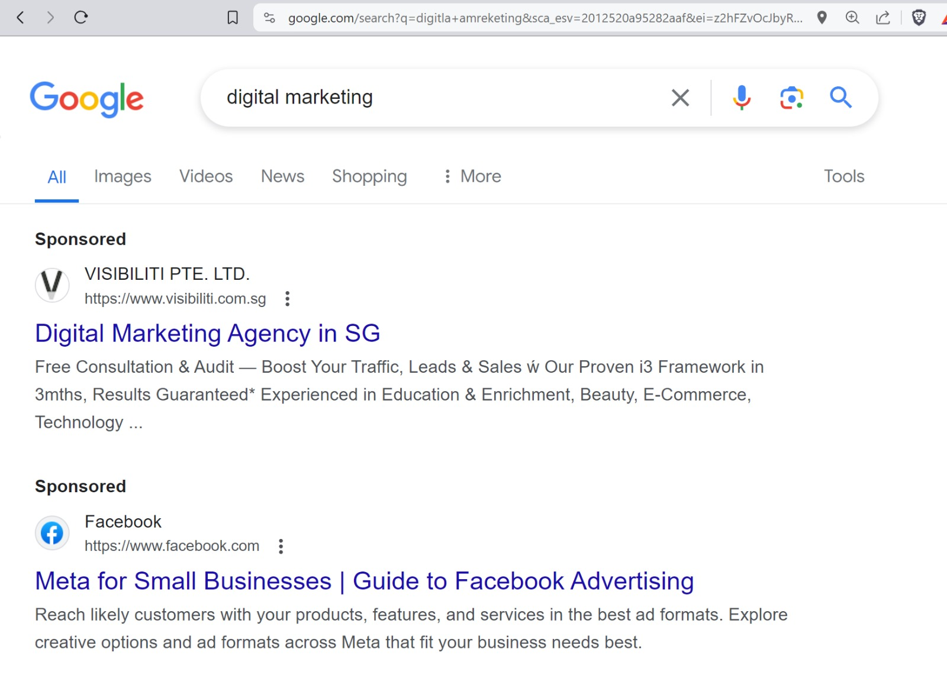
SEM - Google Search Ads
Google Search ads are text ads shown in Google Search Results Pages

Slide 54
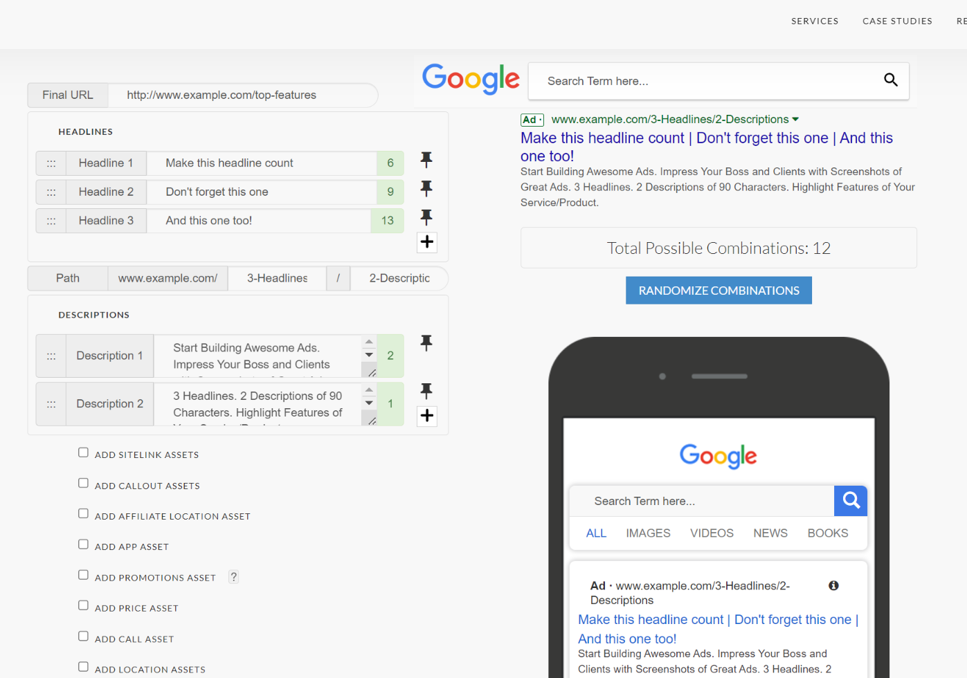
SEM - Google Search Ads (Ad mockups)
Simulate ads here
Use https://nordicclick.com/resources/google-ads-preview-tool/ to mockup search text ads, at least 3 ads
Use 1 ad for each keyword you re targeting

Slide 55
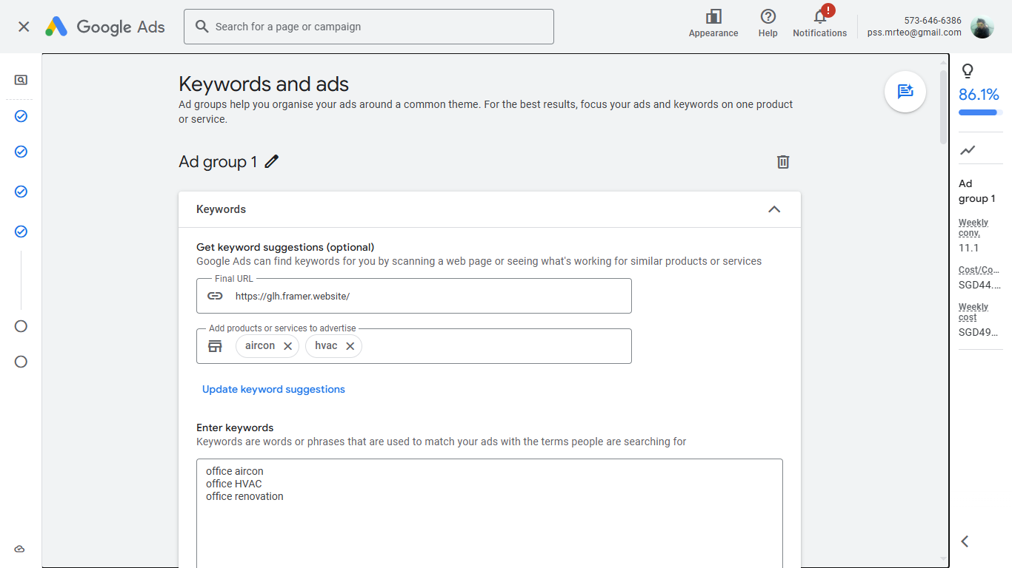
SEM - Google Search Ads (Ad mockups)

Slide 56
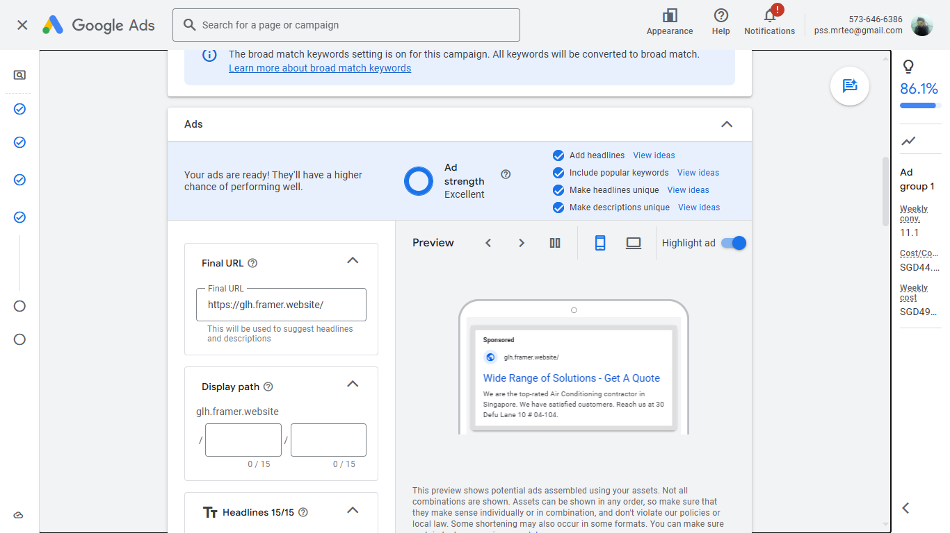
SEM - Google Search Ads (Ad mockups)

Slide 57
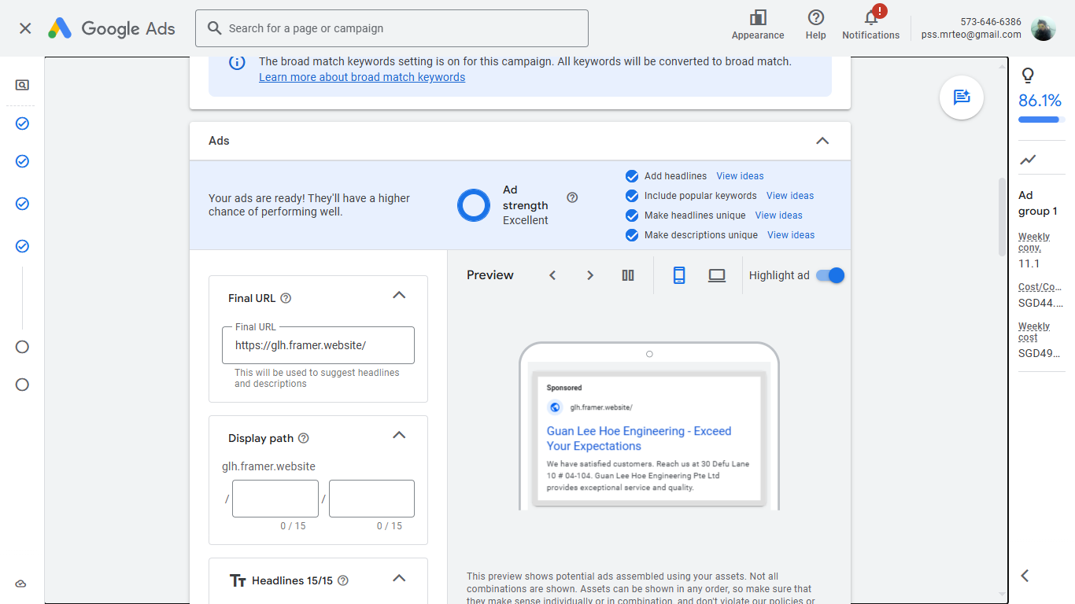
SEM - Google Search Ads (Ad mockups)

Slide 58
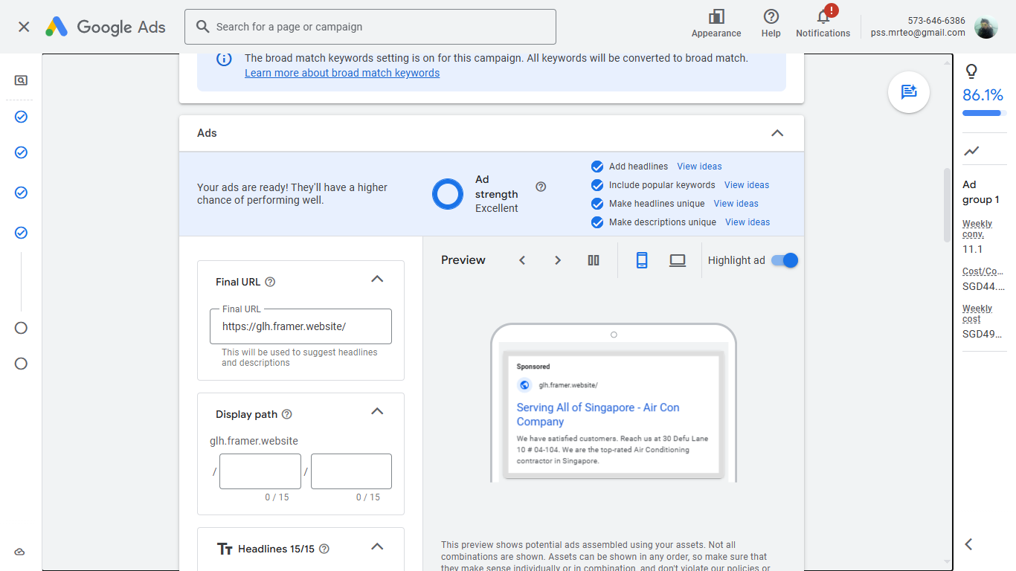
SEM - Google Search Ads (Ad mockups)

Slide 59
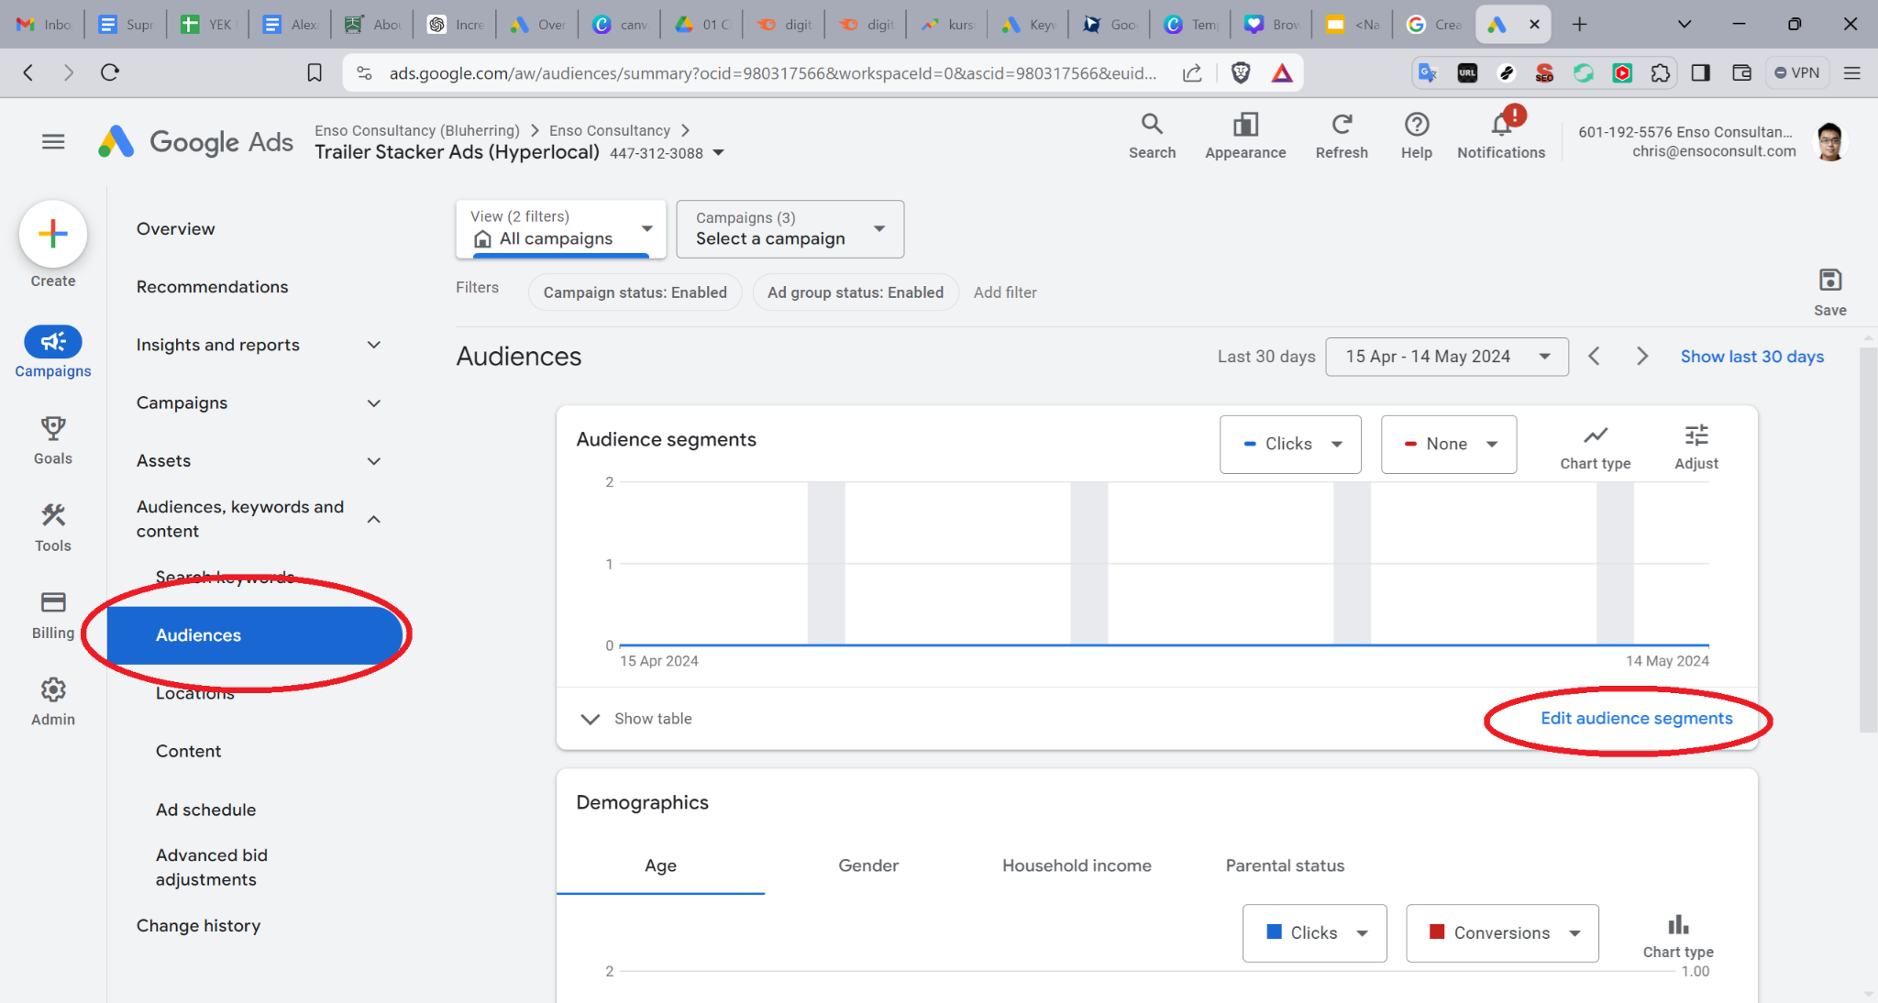
SEM - Google Search Ads (Target Audience)
Simulate your targeted audience segment
Here is how you access it on google ads here

Slide 60
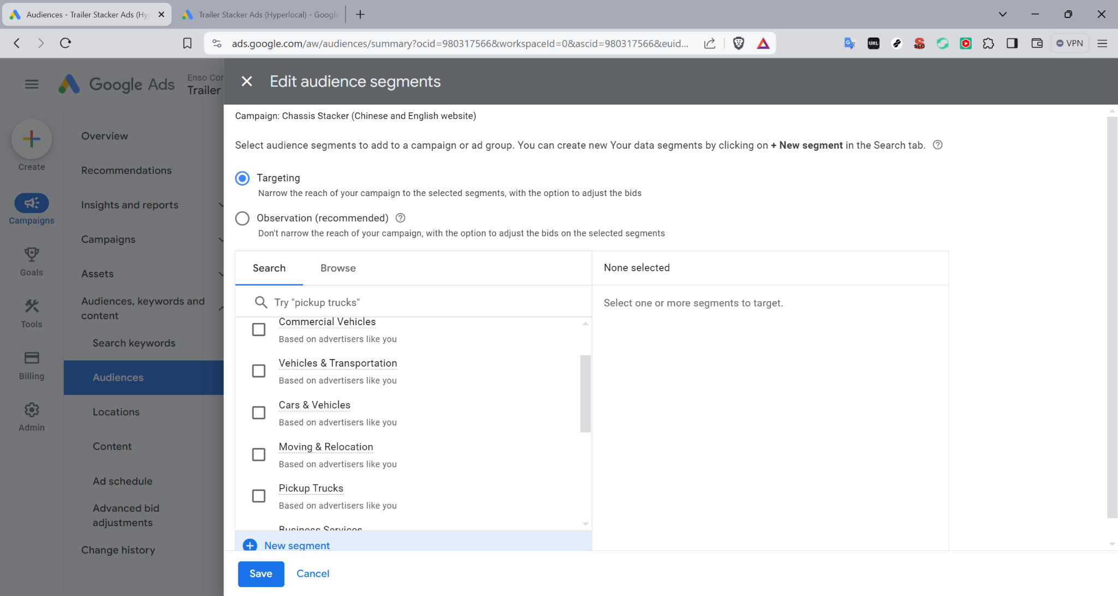
SEM - Google Search Ads (Target Audience)
Audience segments targeting settings is here, show your screenshots of your settings

Slide 61
SEM - Google Search Ads (Target Audience)
Read more about Audience Segments here https://support.google.com/google-ads/answer/2497941

Slide 62
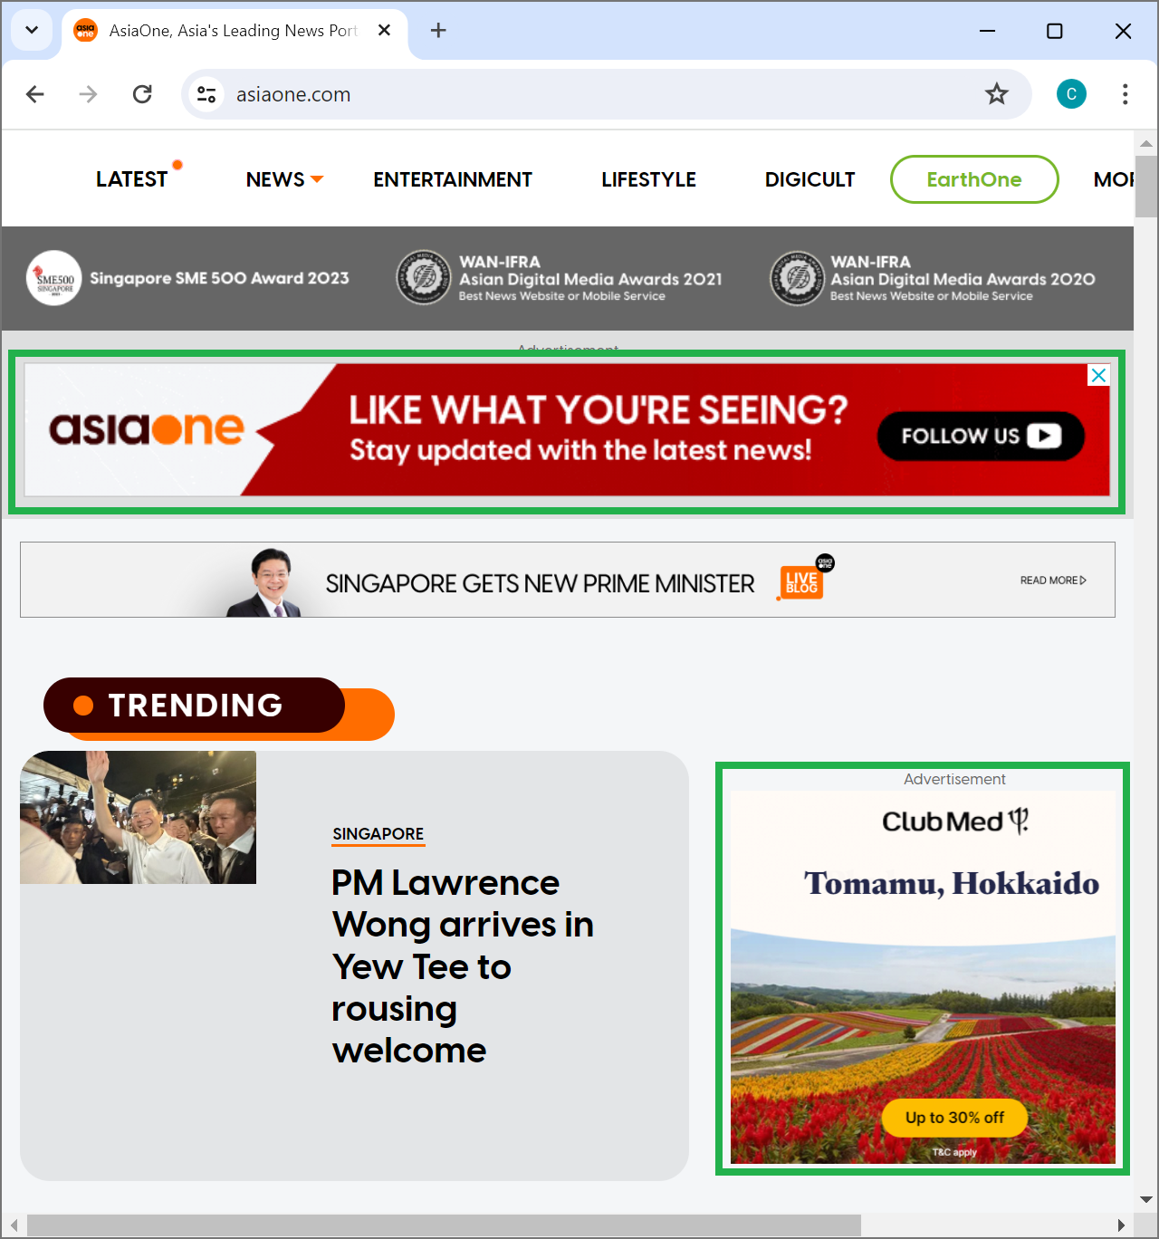
SEM - Google Display Network Ads (Target Audience)
Google Display Ads are image or video ads you see on various websites

Slide 63
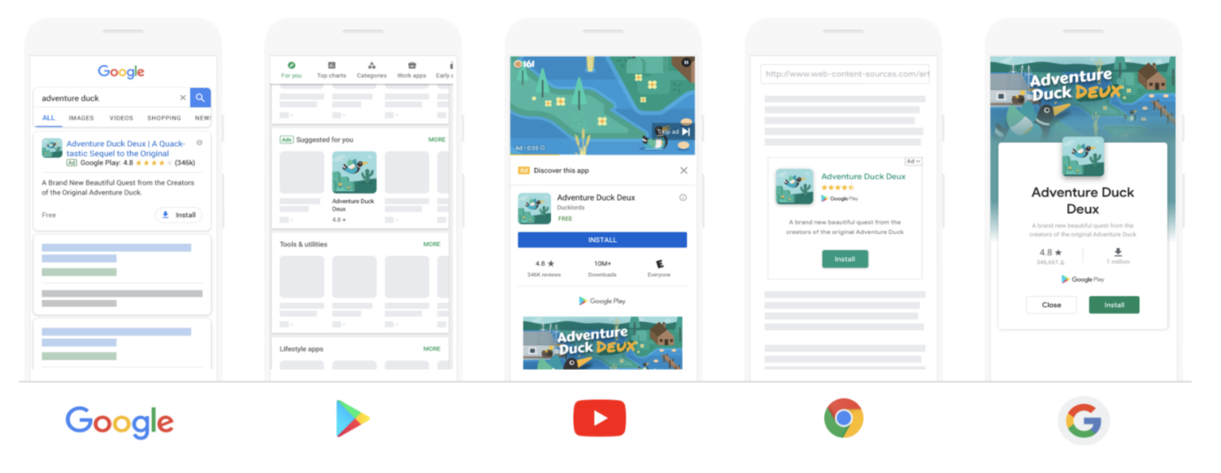
SEM - Google Display Network Ads (Target Audience)
And also in mobile apps

Slide 64
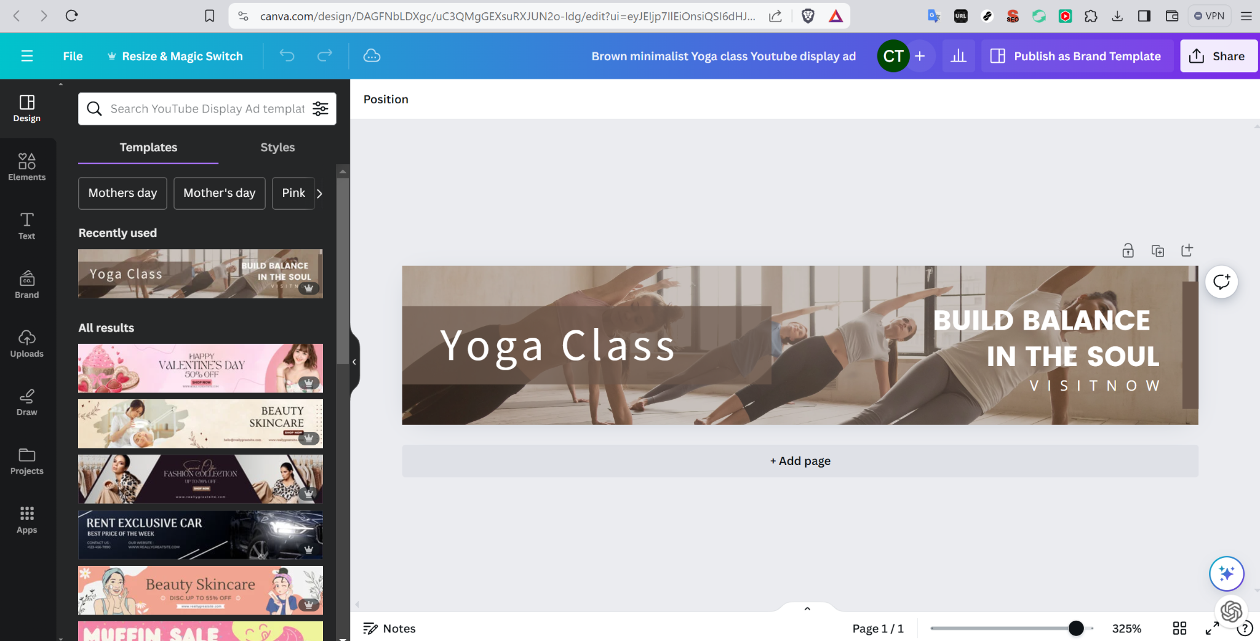
Search Engine Marketing (Google Display Network Ads)
Use canva to create the google display ads, 3 in each of the following format
https://www.canva.com/web-ads/templates/mobile-banner-ads/
https://www.canva.com/web-ads/templates/halfpage-ads/
https://www.canva.com/web-ads/templates/billboard-ads/
Show screenshots in edit mode as per below

Slide 65
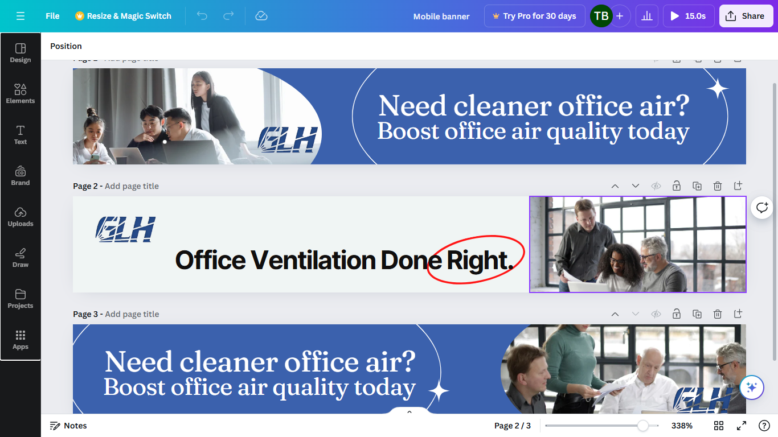
Search Engine Marketing (Google Display Network Ads)

Slide 66
SEM - Google Display Network Ads (Target Audience)
If your audience is different from Search Ads, show screenshot of Google Ads’ audience segments

Slide 67
SEM - Google Display Network Ads (Target Audience)
If your audience is different from Search Ads, show screenshot of Google Ads’ audience segments

Slide 68
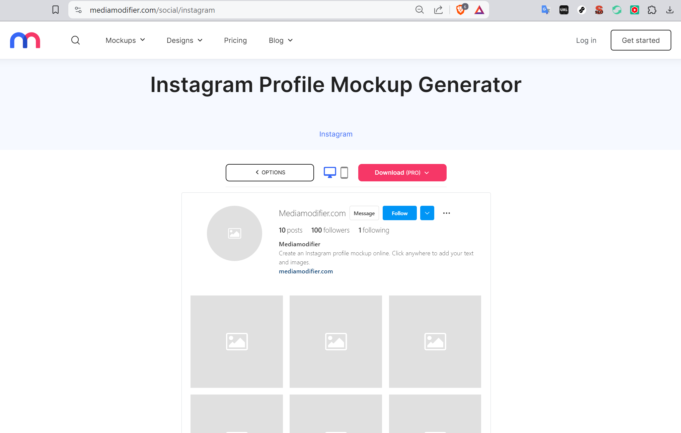
Social Media Marketing (Organic Post)
Simulate creating one social media post using
Use https://www.canva.com/ to create post images
Use https://mediamodifier.com/social/instagram simulate how the post looks, there are other social media channel mockups on this page

Slide 69
Social Media Marketing (Ad)
Simulate the custom audience you are targeting in facebook/instagram
Learn more about saved audiences here https://www.facebook.com/business/help/717368264947302

Slide 70
Social Media Marketing (Ad)
Simulate creating one social media post using
Use https://www.canva.com/ to create post images
Use https://mediamodifier.com/social/instagram simulate how the post looks, there are other social media channel mockups on this page

Slide 71
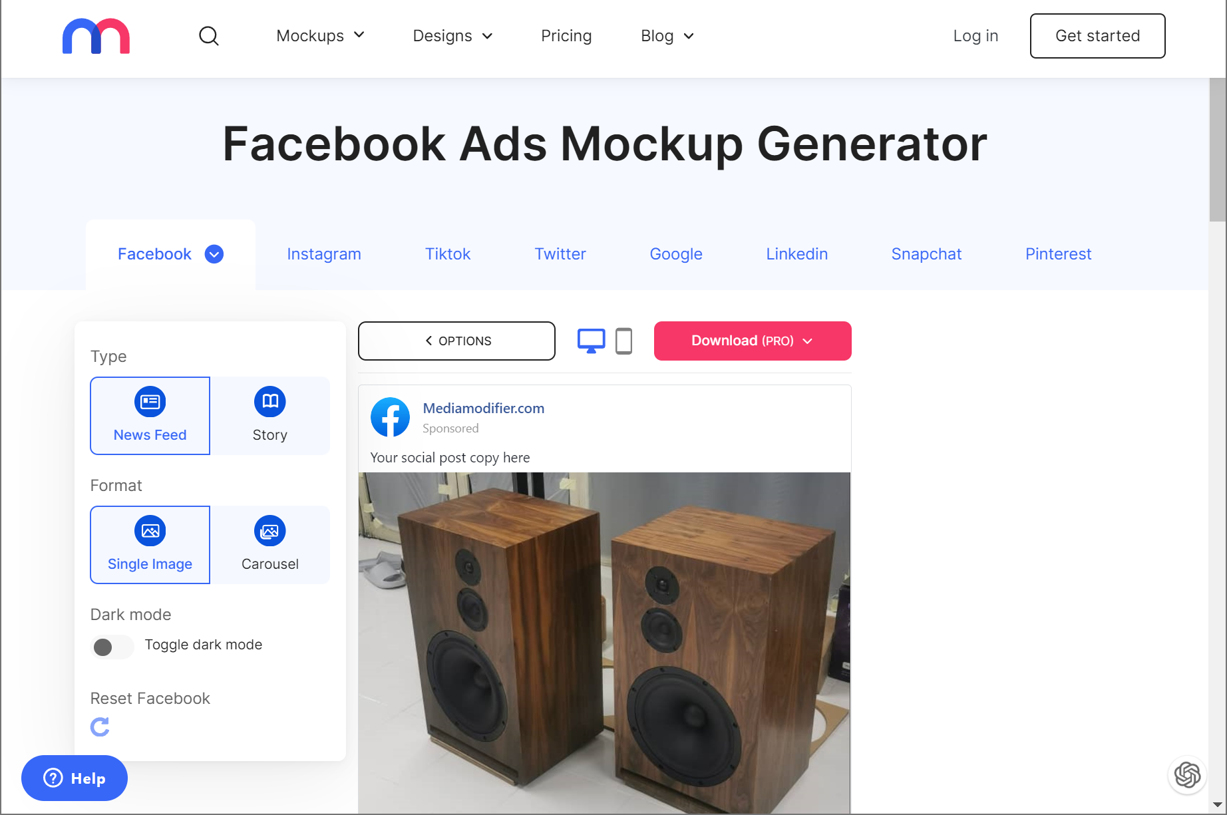
Social Media Posts (Ads)
Simulate setting up social media ads using
Use https://www.canva.com/ to create ad images
Use https://mediamodifier.com/social/instagram simulate how the post looks, there are other social media channel mockups on this page

Slide 72
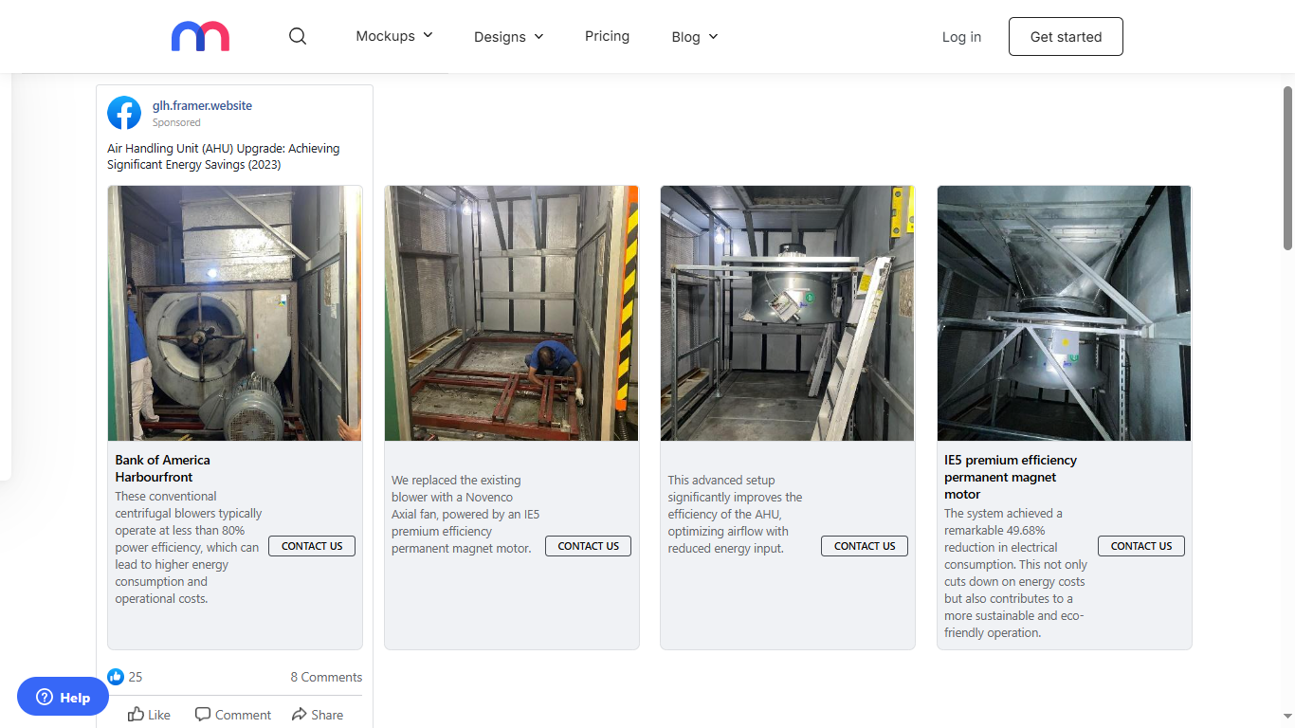
Social Media Posts (Ads)

Slide 73
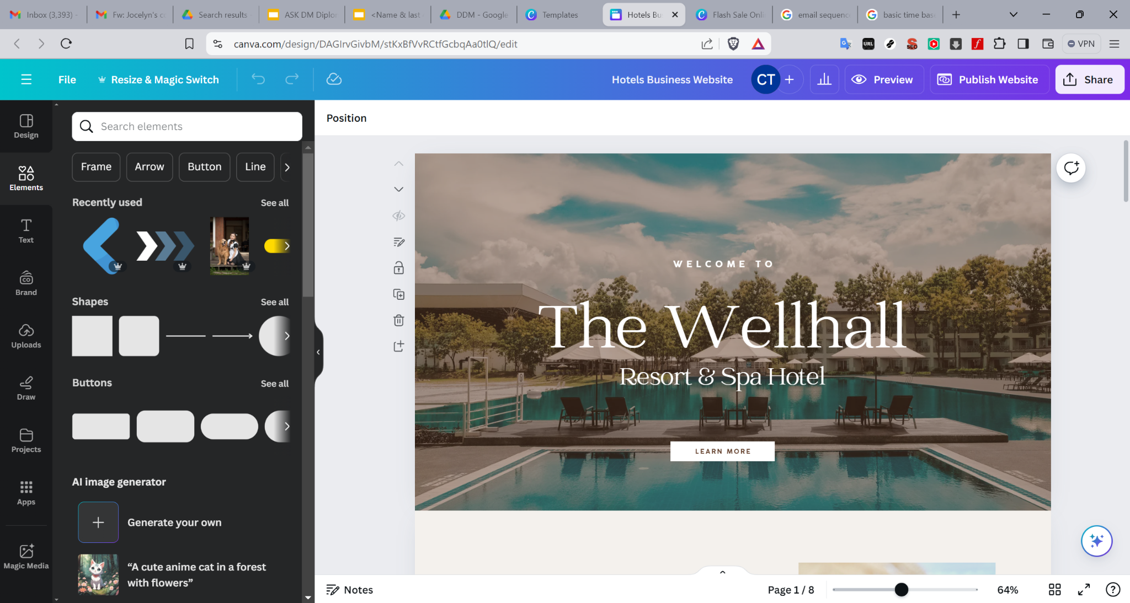
Landing Page
Create and share screenshot of your landing page in edit mode here

Slide 74
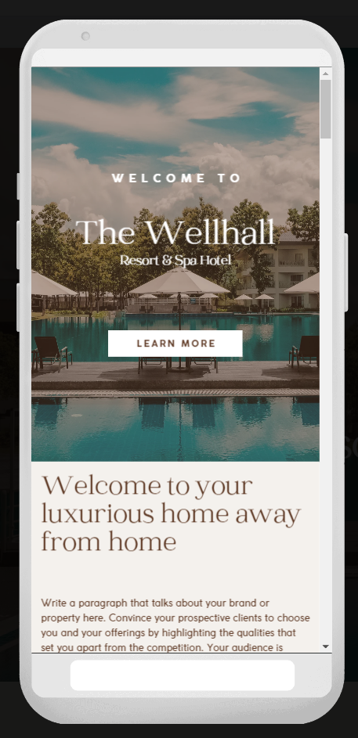
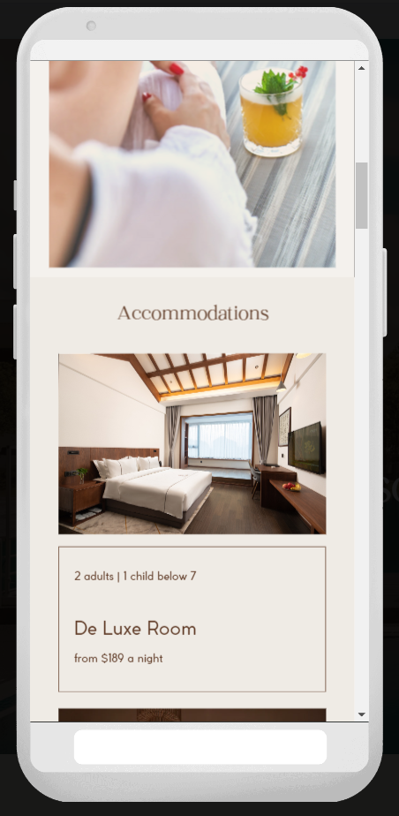
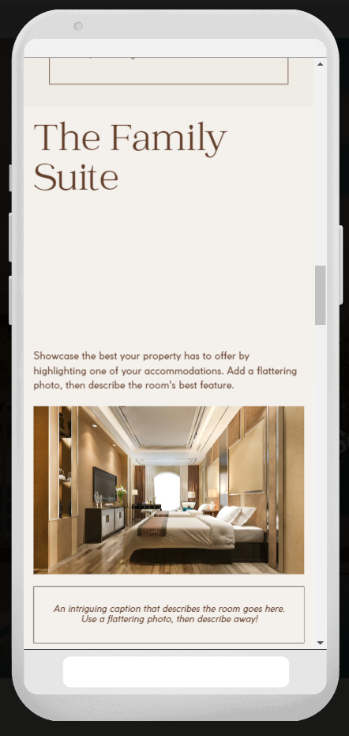
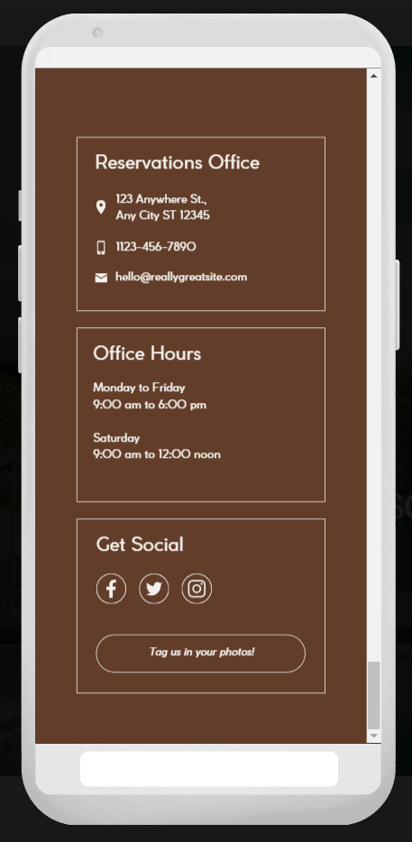
Landing Page
Share screenshots of your landing page in preview mode for Mobile

Slide 75
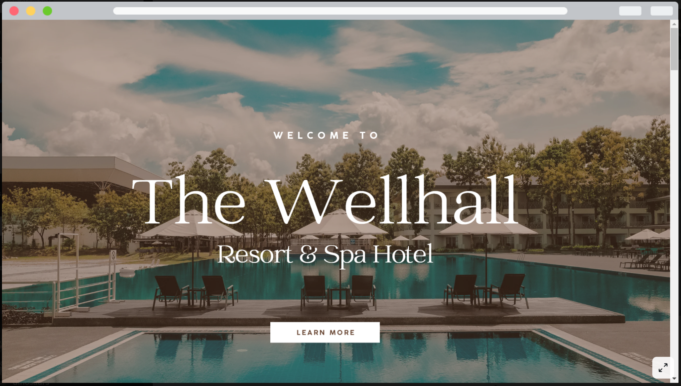
Landing Page
Share screenshots of your landing page in preview mode for Desktop, include as many screenshots needed to show all parts of the landing page

Slide 76
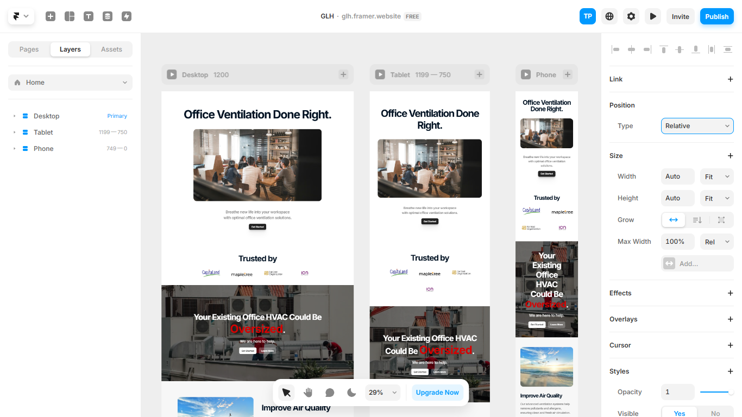
Landing Page

Slide 77
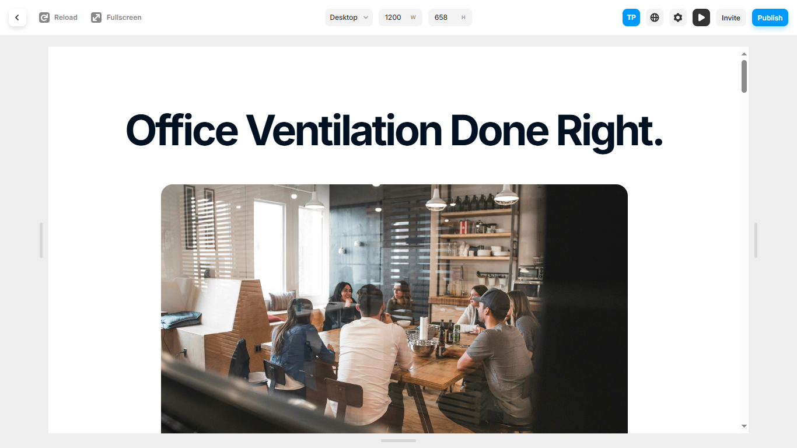
Landing Page (Desktop View)

Slide 78
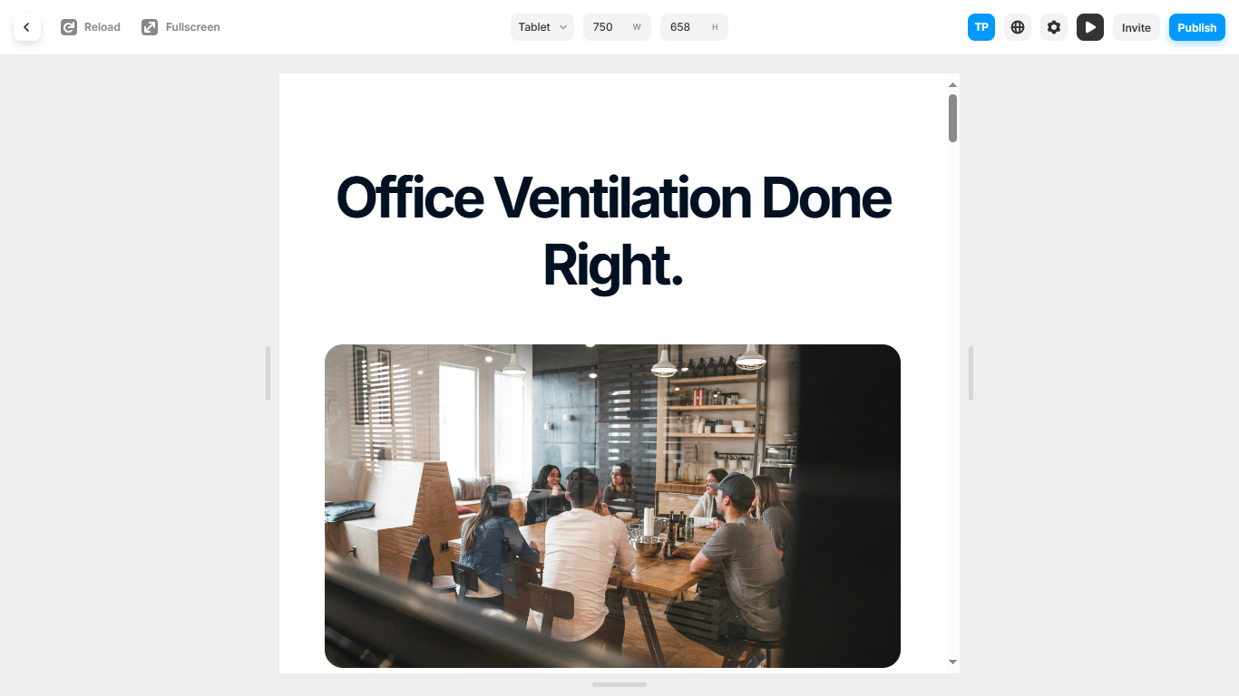
Landing Page (Tablet View)

Slide 79
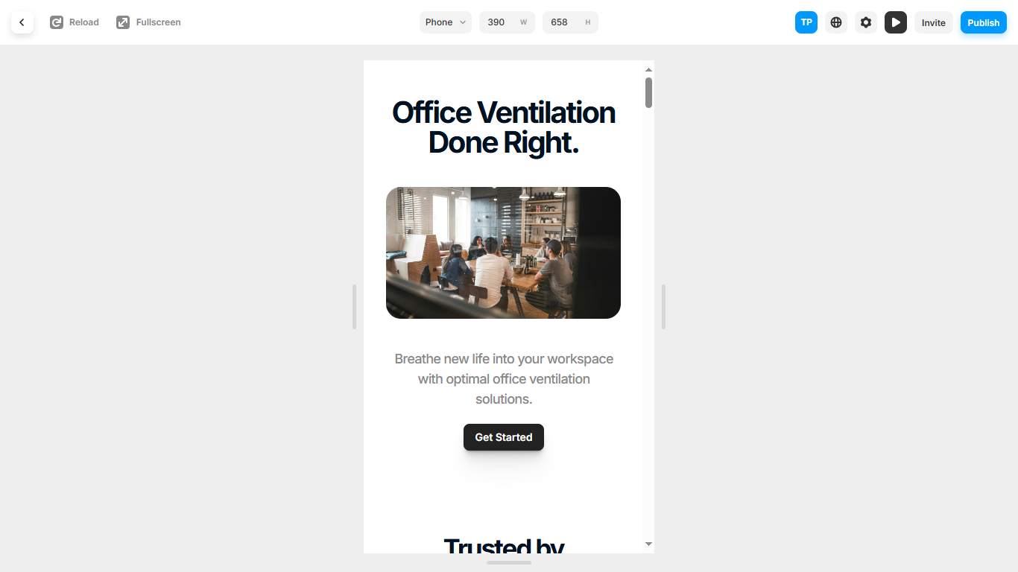
Landing Page (Phone View)

Slide 80

Landing Page (Link)
glh.framer.website

Slide 81
SMART Goals
Come up with smart goals, 1 per marketing channel define whether it is awareness, consideration or decision of the customer lifecycle
Channel | Metric | KPI | Duration | Notes (if any)
FB Ads | No. of Clicks | 100 | in 3 months time | Awareness
Google Search Ads | No. of Clicks | 100 | in 3 months time | Awareness
Google Display Ads | No. of Clicks | 100 | in 3 months time | Awareness
FB Page | Followers | +50% | in 3 months time | Interest
Landing Page | Website Visitors | +20% | in 3 months time | Desire

Slide 82
Email Marketing
Create an email drip sequence
# | Content of email | Call To Action in Email
1
2
3
4
5

Slide 83
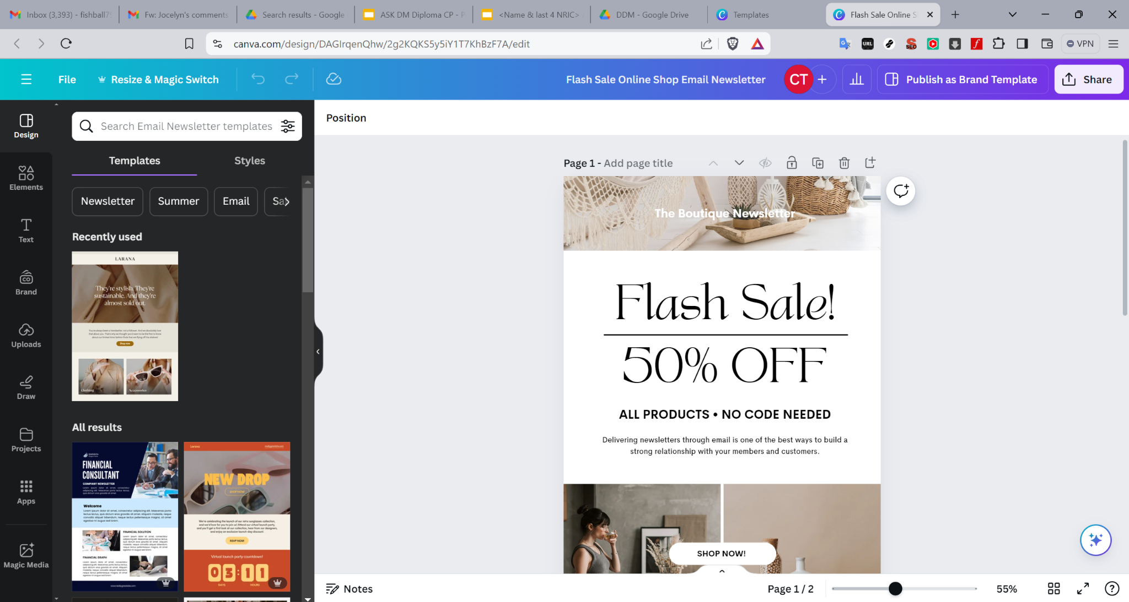
Email Marketing
Create and share screenshots of one sample email in your drip marketing (if any)

